Slide 1
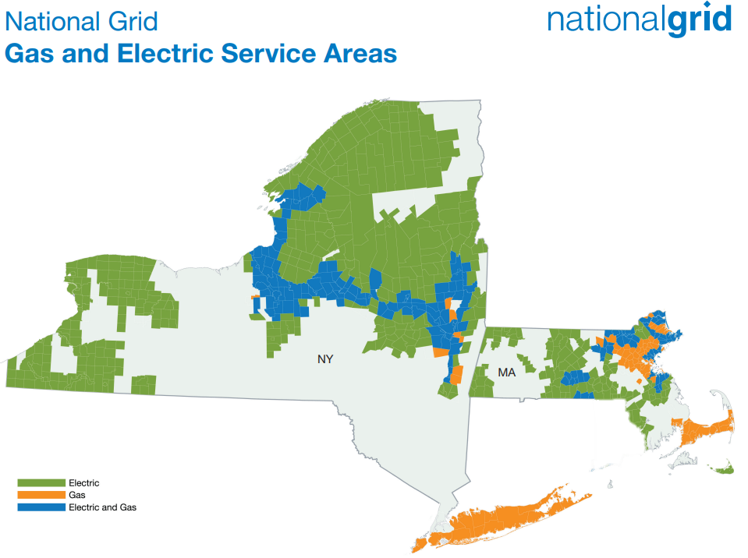
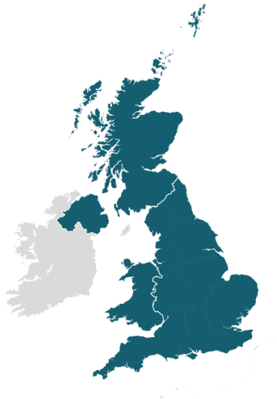
 | NY Gas | NY Electric
Rate base | $11.6B | $7.0B
Customers | 4M | 2.4M
Employees | ~8,000
National Grid Ventures
Unregulated competitive business
Energy Services
Renewable Development
Venture Capital
 | MA Gas | MA Electric
Rate base | $4.2B | $3.1B
Customers | 2.3M | 2.4M
Employees | ~6,500
National Grid UK
Electricity Transmission
Electricity Distribution
Electric System Operator (ESO)

Slide 2
4 key trends are driving us to transform and build our networks to enable a clean energy future
1
State and Federal policies promote clean energy
2
Customers are adopting new technologies
3
Renewable costs are falling
4
Customers want convenience, choice, & control while maintaining affordability & reliability
CLCPA & NYS Goals:
2030: 10 GW PV
2030: 6 GW storage
2035: 9 GW wind
2040: 100% LDV sales ZEV
2040: 100% zero carbon electricity
Federal IRA:
Production tax credits plus investment tax credits of 30-50% for solar, wind, and storage through 2033. Tax credits for EVs & HP
CCVS in NY:
Reliable and resilient energy delivery

Slide 3
The Climate Leadership and Community Protection Act lays out New York state’s goals and commitments to reduce economy-wide greenhouse gas emissions.
The CLCPA, signed into law on July 18, 2019, requires a 40% reduction of greenhouse gas emissions by 2030 and at least an 85% reduction by 2050 from 1990 levels.
2025
2030
2035
2040
2050
6 GW
Distributed solar
70%
Renewable energy
generation
9 GW
Offshore wind
100%
Zero-emission
electricity
85%
Reduction in GHG emissions
185_{Tbtu}
Energy consumption savings
40%
Reduction in GHG emissions
100%
Zero-emissions light duty vehicle sales
6 GW
Energy storage
CLCPA Progress

Slide 4
National Grid’s strategy in NY must enable the CLCPA goals, while maintaining reliability and affordability for customers.
The NY PSC is responsible for ensuring that utilities “provide safe, adequate, and efficient service at just and reasonable rates, with concern for the environment.”
Electric reliability is measured with two metrics: the System Average Interruption Frequency Index (SAIFI) and the Customer Average Interruption Duration Index (CAIDI).
Gas Safety Performance Measures, including emergency leak response time, track the safe operations of gas utilities.
Reliable
Regulated utilities must follow a formal process, requiring approval from the NY PSC, in order to increase customer rates. The rate case filing includes a summary of operating expenses, depreciation costs, and taxes to demonstrate need for a higher cost to rate payers.
Affordable
Notes:
https://dps.ny.gov/electric
https://dps.ny.gov/system/files/documents/2023/08/electric-service-reliability-report-2022.pdf
https://climate.ny.gov/Our-Impact/Addressing-Energy-Affordability-Concerns
https://dps.ny.gov/major-rate-case-process-overview
file:///C:/Users/marsil/Downloads/%7BB898838A-6F94-4CB6-99DA-F0622CB2B89D%7D.pdf
https://dps.ny.gov/system/files/documents/2023/08/electric-service-reliability-report-2022.pdf

Slide 5
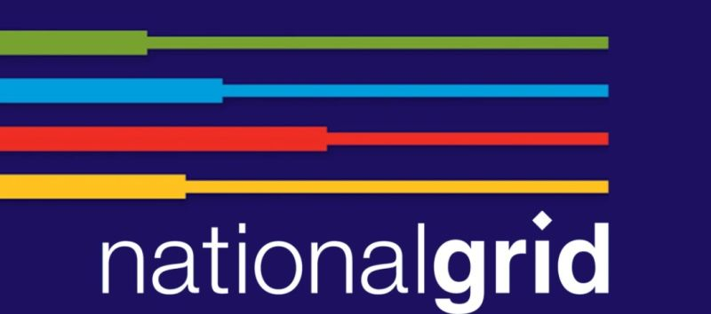
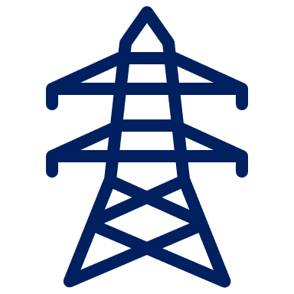
A successful clean energy transition requires a complete transformation of our energy systems.
Innovative
Sustainable
Fast
Clean
Fair
Safe
Affordable
Reliable
Accessible
Inclusive
Resilient
Smart

Slide 6
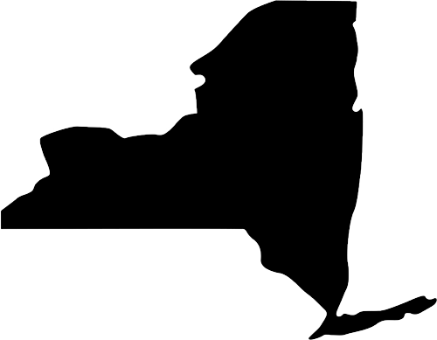
At National Grid, our vision is to be at the heart of a clean, fair, resilient and affordable energy future.
Interconnect Large Scale renewables
Enable and Optimize local DERs
Reduce demand through EE and DR
Utilize Storage
Advance Clean Transportation
Decarbonize out gas networks through use of RNG and hydrogen
Integrate innovative technology to decarbonize heat
Build the grid of tomorrow to maintain reliability and resiliency in the future and accommodate more DERs
Diverse customer base will need a diverse set of energy affordability program
Leverage digital products and integrated energy planning across electric and gas to further optimize capital project costs
Accelerate social mobility in the communities we serve (higher clean energy jobs in state)
Invest in our people and build the skills needed to deliver a clean energy future
Future Digital technologies will support reliability and resiliency as the electric grid becomes more complex
Grow our capability in new technologies for areas such as fossil free heating
Future operating platforms such as ADMS and DERMs will help to enable and monitor future markets for energy products
Hire and develop employees needed to deliver a clean energy future
Empower employees with proper on the job training
Keep promoting our company’s culture of “safe to speak” so that employees feel comfortable to voice their opinion
Create a diverse workforce that reflects the community we serve

