Slide 1
Carbon Insurance: How to Unlock Financing and De-Risk Carbon Projects
James Kench CFA – Head of Insurance

Slide 2
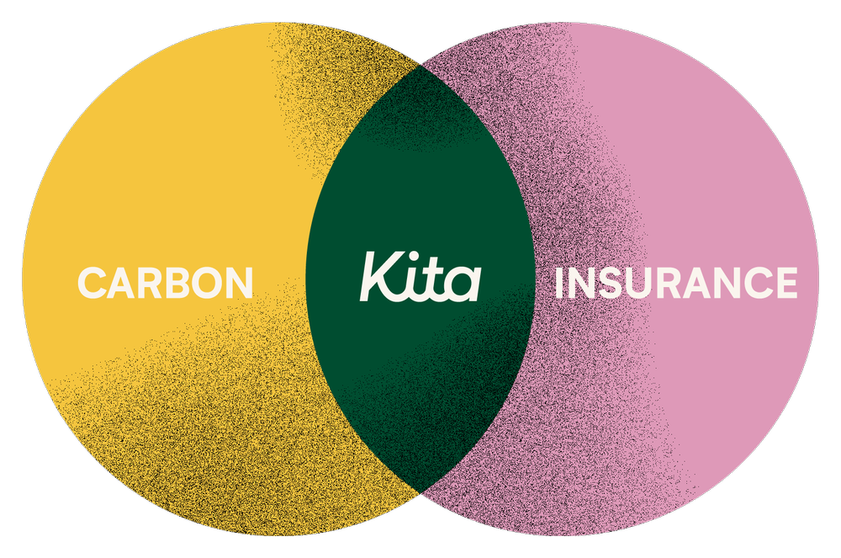
Carbon Markets
An Investment Opportunity & Potential Liability…Currently Uninsured
Notes:
Purpose: Overview of Kita and how we see insurance as a key enabler to de-risk financing into carbon projects.
Kita: We Insure Carbon
Insurance firm to de-risk high-quality carbon projects to enable them to scale.
See insurance as a key to unlocking institutional capital that the sector needs.
Building bespoke insurance products to solve pain points of market as they scale, to do so we:
Look at whole lifecycle of carbon credit (come to this later)
Key stakeholders (buy-side / sell-side / intermediaries).
All types of carbon project (NbS and Engineered, VCM and Compliance).
Logistics: 10-15 min presentation, then 5 min Q&A.
Agenda:
Why is insurance a key enabler for climate finance and risk taking?
What risks in the carbon markets are insurable?
How does carbon insurance unlock more finance?
Q&A

Slide 3
About Kita
Lloyd’s of London Innovation Alumnus | Backed by Leading Global (Re)Insurers
A Excellent
A.M. Best
AA- Very Strong
Fitch Ratings
AA- Very Strong
Kroll Bond Rating Agency
AA- Very Strong
Standard & Poor’s
Notes:
Lloyd’s of London – global specialist insurance & reinsurance marketplace.
AA credit rating in our policies = peace of mind & capital relief.

Slide 4
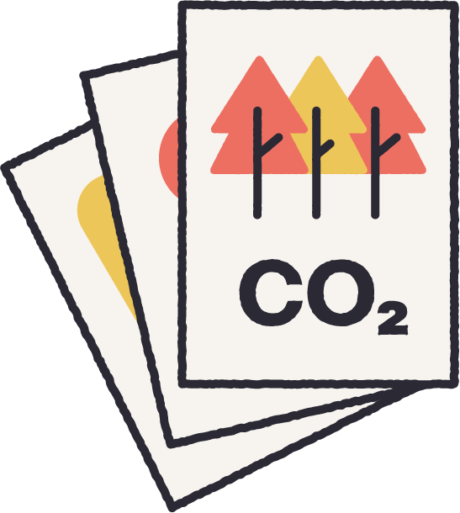
Why Insurance?
Insurance = Swap uncertainty of future losses with certainty of insurance premium
Transfer
Avoid
Contracts
Insurance
Unsustainable business model
Severity ($ Impact of Losses)
Accept
Reduce
Cost of doing business
Assess
Prioritize
Mitigate
Frequency (# of Losses)
Notes:
Role of Insurance is to assess, price and transfer risk.
Swap uncertainty of future losses with certainty of premium.
Insurance is a key risk management tool.
Risk Management is about assessing, prioritizing & mitigating risk.
It is helpful to think about this in the context of potential frequency & severity of losses (e.g. $ at risk).
Insurance role is manage volatility against low-frequency, high-severity events.
Insurers really appreciate firms (buyers & sellers) with good risk management & due diligence = more information & better.
As mentioned, if buying credits, then buying risk, but let’s break down those risks…

Slide 5
Why Insurance?
Our Business is Risk
Risk Management
Risk pricing signal
Stamp of confidence
Improved financing
Lower cost of capital
Risk Assessment
Risk Transfer
Insurability
Physical risks
Intangible risks
Manage volatility
Downside protection
Credit wrapper
Flexibility in claims: cash or carbon
Risk Taking
Secure supply
Lock-in preferred pricing
Confidence to invest
Notes:
A balance between traditional risk management practices and innovation; a stamp of confidence; a detailed assessment of carbon project risk; encourage market participants to take risks.
Applying insurance-led analysis to carbon transactions leads to an increase in standards of delivery, transparency and management and supports price differentials that drive a flight to quality
“Risk transfer solutions…are financial shock absorbers, reducing a company’s potential financial loss if a risk manifests and smoothing its experience in volatile conditions.” - CREO, “An Introduction to Risk Transfer Solutions for Climate Projects”
by transferring risk off balance sheet, companies can accelerate (or can we say 'leverage'?) their impact via investing in more projects
What can carbon insurance offer?
The ability to lock in preferred pricing and secure supply, safeguarding climate commitments
Confidence that strong due diligence and risk management is in place
Reduce risk on your balance sheet
Enable improved financing terms / lower cost of capital
Flexibility in how eligible claims are settled: opt for cash or replacement like-for-like carbon credits
The ability for insurance to be used to wrap uncertain/new businesses with a regulated, high credit rating, low counterparty risk, financial institution. for buyers making prepayments/investments into projects, the existence of insurance to protect underdelivery should unlock much cheaper bank financing
Even if buyers are not seeking bank financing of their prepayments/investments, having insurance may open up the possibility of banking instruments like receivables purchasing agreement (this is more of a longshot)
You could also mention that providing us with capacity and thus underwriting these projects, is a diversified, nice return and fights climate change.

Slide 6
Which Risks Need Insurance? Physical v Intangible
Amazing Mentors
Risks to Physical Asset
Risks to Intangible Asset
Natural Catastrophe.
Underperformance.
Supply Chain.
Operational / Machinery.
Forecasting, Methodologies, Reserves.
Monitoring, Reporting, Verification.
Permanence, Invalidation, Usage.
Non-Delivery
Price
Reversal*
Counterparty
Invalidation
Political
Notes:
In terms of risks for carbon credits, there is a nuance between physical risk to the project and the risks to the carbon credits.
Some overlap, some are specific.
Insurance can take this into account.
Similar in some ways to physical commodities markets – e.g. Oil firm has risks that are different to buyer vs traders of oil.
Nuance is: end product isn’t physically delivery like oil, but intangible.
6 broad risk themes, as well as reputation risk.
Explain these over lifecycle of a credit on next slide.

Slide 7
Carbon Insurance Risks over the Credit Lifecycle
VALIDATION
ISSUANCE
Reputational = Pervasive
Non-Delivery
Price
Risk
Reversal
Counterparty
Invalidation
Risk Assessment
Non-Delivery / Non-Payment Risk
Fraud & Negligence
Political
Concept
Execution
Lifecycle
Retirement
Notes:
Looking at risk over lifecycle of a credit, we see 3 main phases, with 2 key milestones.
Concept
Execution
Retirement
Validation
Issuance
Will run through these each briefly, but there’s a ton of risk both early on (non-delivery) as well as post-issuance.
X6 key risk themes + reputational”
reputational is pervasive: companies want to do the right thing.
Buying credits= buying risk.
Reputational: The risk that an organisation may suffer reputational damage due to factors such as the credit used or claims used/end-use of the credit.
Non-Delivery: The risk that the credits expected/promised from a project are not delivered in part or in full. This is where Kita’s main product comes in (later slide)
Price: For companies that trade or invest in carbon credits, market prices can be turbulent. For companies that use carbon credits to meet net zero targets, price poses a wider risk. If a corporate is forced to replace carbon credits due to invalidation, it takes on a potentially uncapped future liability by being forced to replace those credits at unknown future prices.
Reversal: The risk that carbon captured by a project may be re-released into the atmosphere. This risk is most significant for forestry and land-use projects, for example if a forest burns down. Engineered solutions could suffer a reversal, for example if carbon stored underground leaked or biochar for change of use – eg burnt for energy.
Counterparty: The risk that parties within the transaction may default on the contract and not fulfil their obligations. This can be a particular concern within the VCM, as it is an unregulated market with a large number of small companies in a wide range of jurisdictions. A lack of standardised contracts can exacerbate this risk.
Invalidation: The risk that the carbon credits or an entire project are invalidated, for example due to a fraudulent or negligent act, a significant reversal of carbon dioxide back into the atmosphere or a significant shift in methodology. Kita provide coverage for this also.
Political: The risk that a host country may alter its regulations, impacting the carbon project, transaction or sale of credits. This is an emerging risk, in particular for Article 6 markets.
These are key risk themes and relative risk level over life of a credit. Will just show how we think about the non-delivery & non-payment aspects in particular.

Slide 8
Carbon Insurance Non-Delivery or Non-Payment Risk
Non-Payment
Lenders
$
$
Non-Payment due to: Non-Delivery
CO₂e
Recourse
Non-Delivery due to: Avoidable / Unavoidable / Carbon Risks
$
CO₂e
Recourse
CO₂e
Recourse
Buyers
Structurers
Developers
Delivery
Performance
$
$
$
CO₂e
CO₂e
CO₂e
Insurable Risks
Delivery
Project under-performance
Credit
Performance
Notes:
Insurance for:
1. buyers/investors who pre-purchase credits or invest for a future stream of credits.
2. lenders who are financing players in the value chain against non-payment.
Non-delivery means:
X tonnes of Carbon at Y $ per tonne for delivery at date Z.
If don’t receive all or part of carbon, then Kita makes whole.
Cash or like-for-like carbon credits.
‘All Risks’ product, covers: avoidable, unavoidable and changes to carbon standards.
Only exclusion is political risk (working on new product for this).
Non-payment: traditional credit insurance product, eligible for capital relief and therefore lower Cost of Capital and risk-adjusted returns.

Slide 9
Questions?
Notes:
Thank you!

Slide 10
We Insure Carbon
www.kita.earth
Notes:
Thank you!

