Slide 1
2024 Trends & Outlook
Micah Kotch
WSG 2024
micah@blackhornvc.com

Slide 2
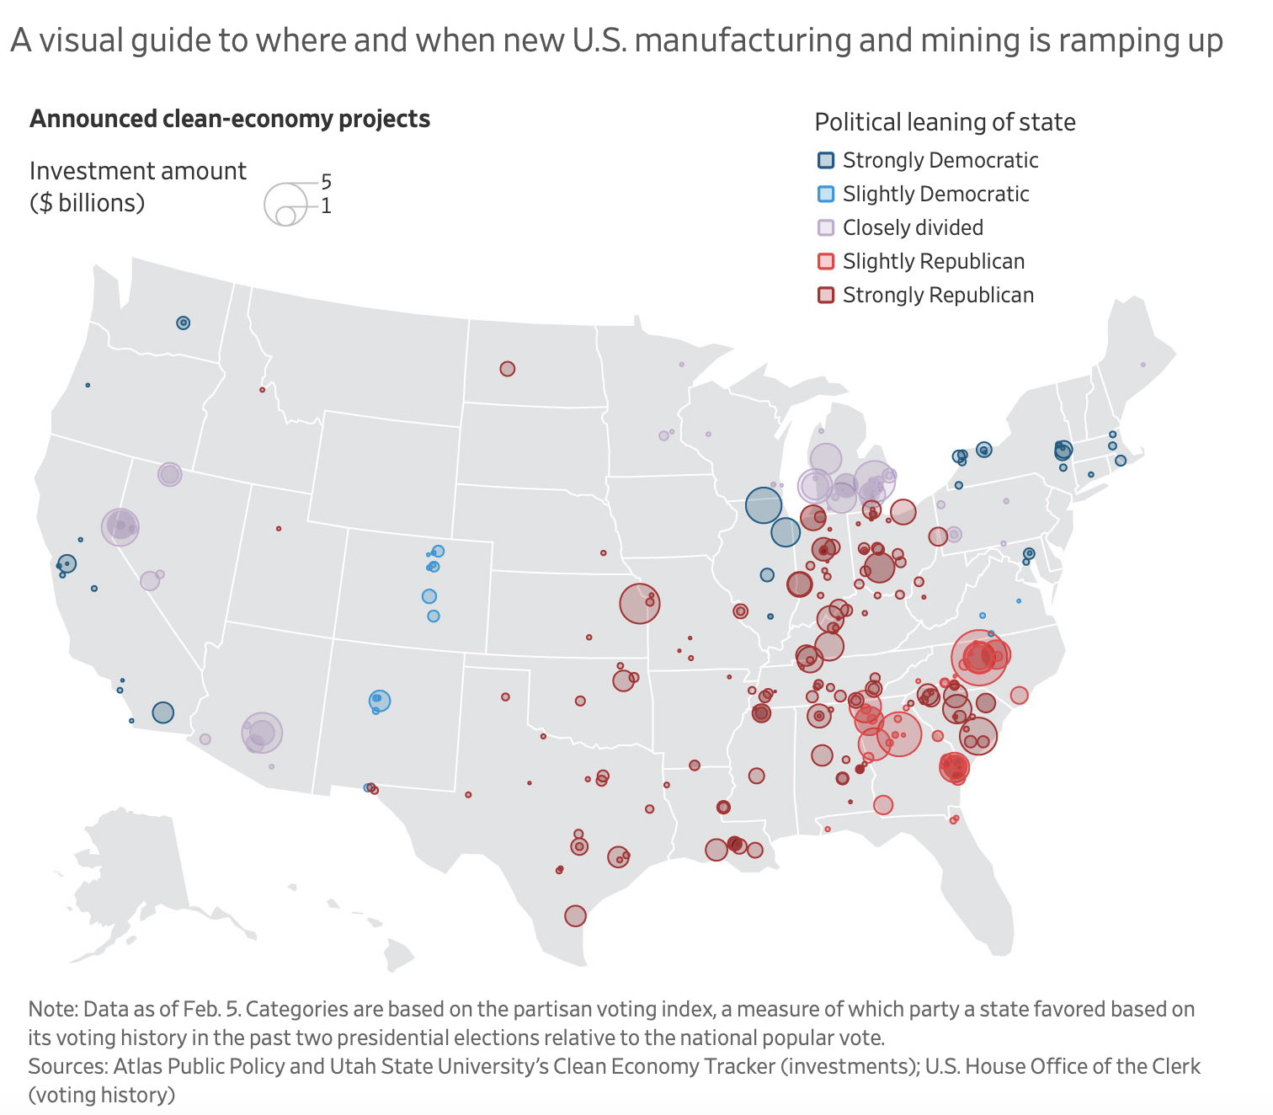
Notes:
The US Clean Investment Monitor published its annual report for 2023, which saw clean investment total $239bn, up 38% from 2022. Winners include manufacturing, up 133% from 2022, and emerging climate technologies that saw a whopping 10x jump to $4.3bn.

Slide 3
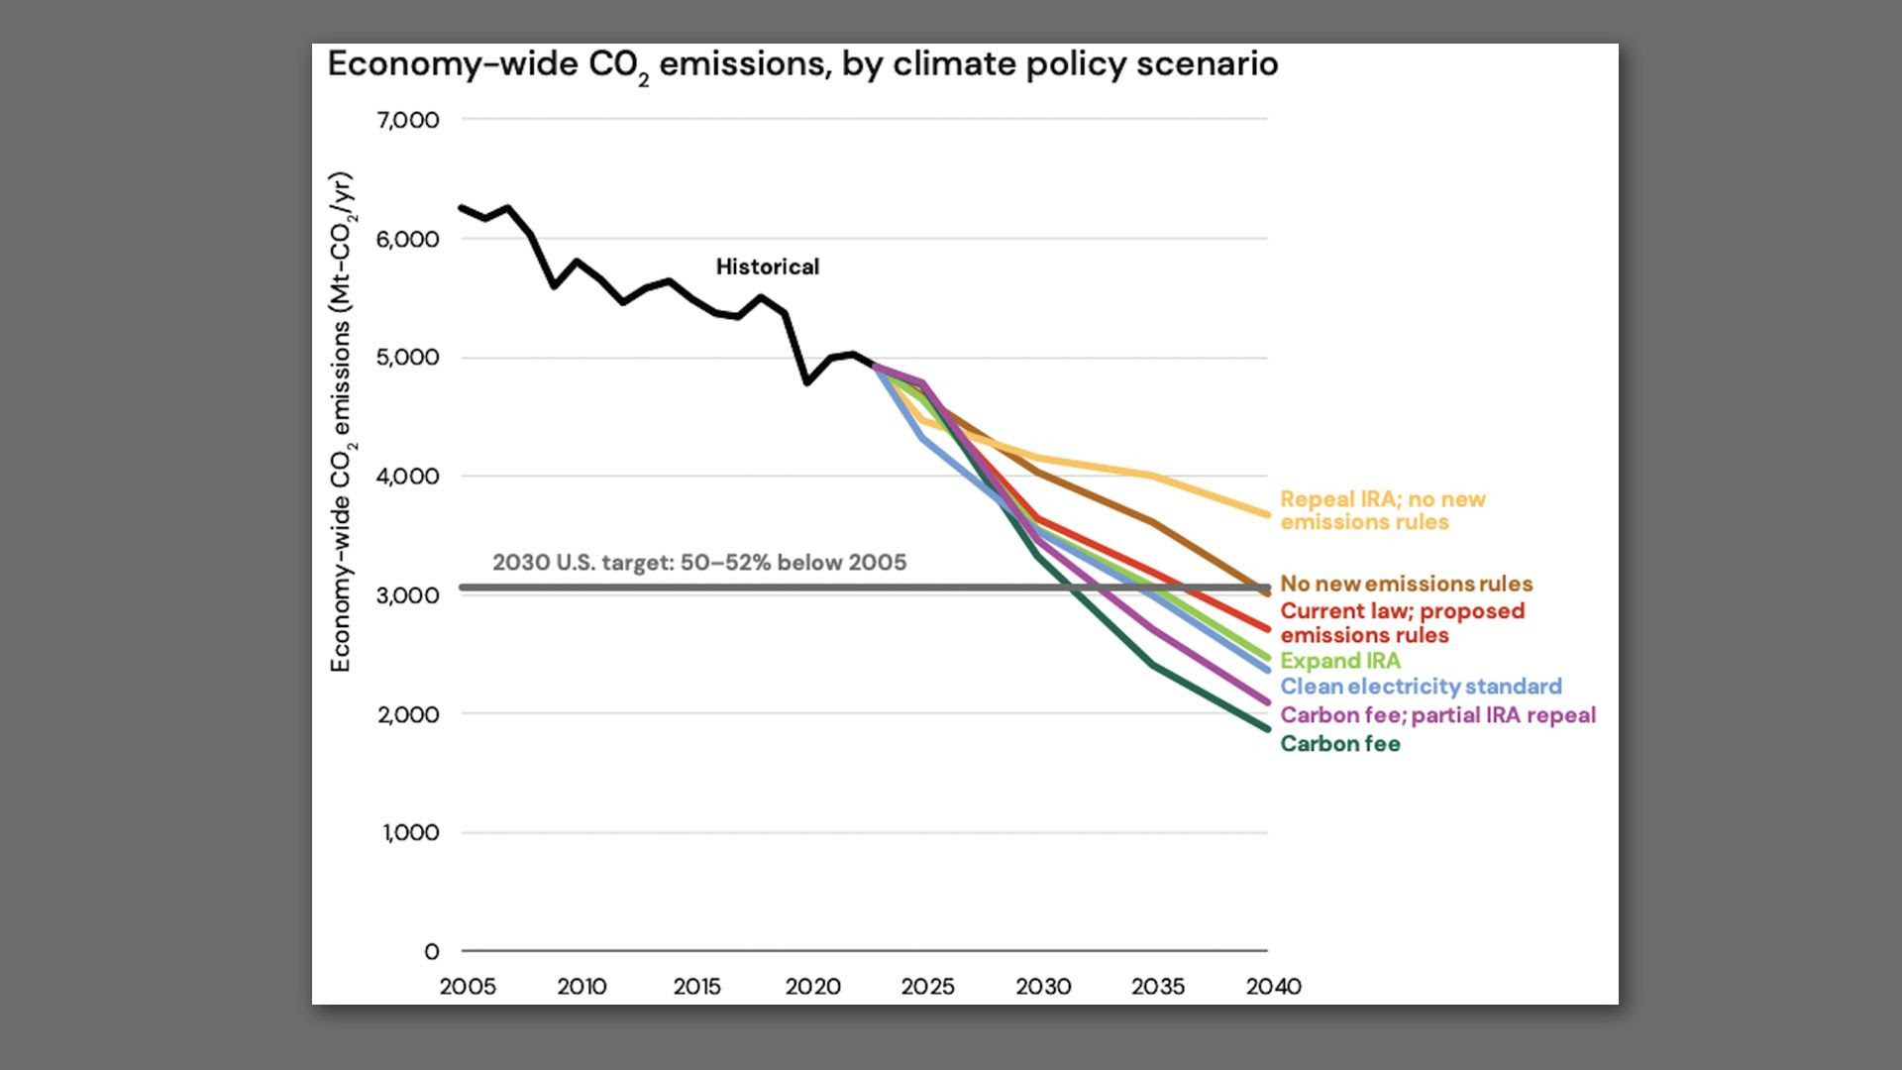

Slide 4
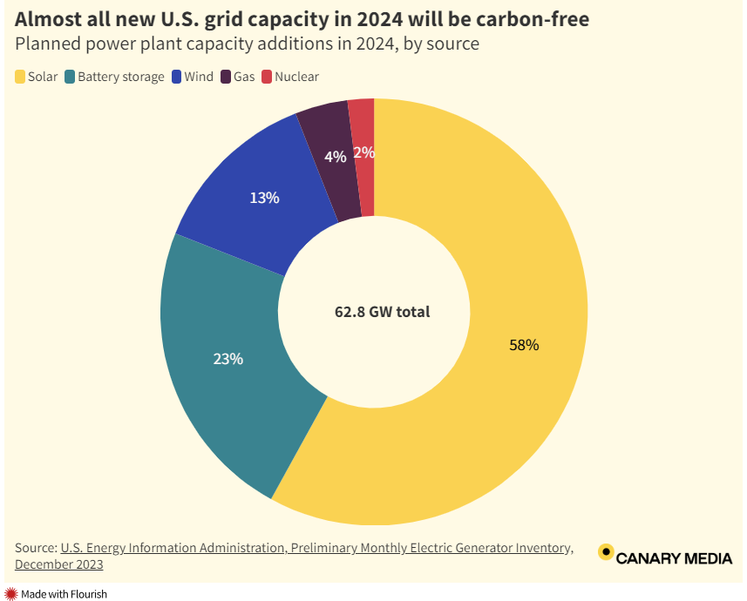

Slide 5
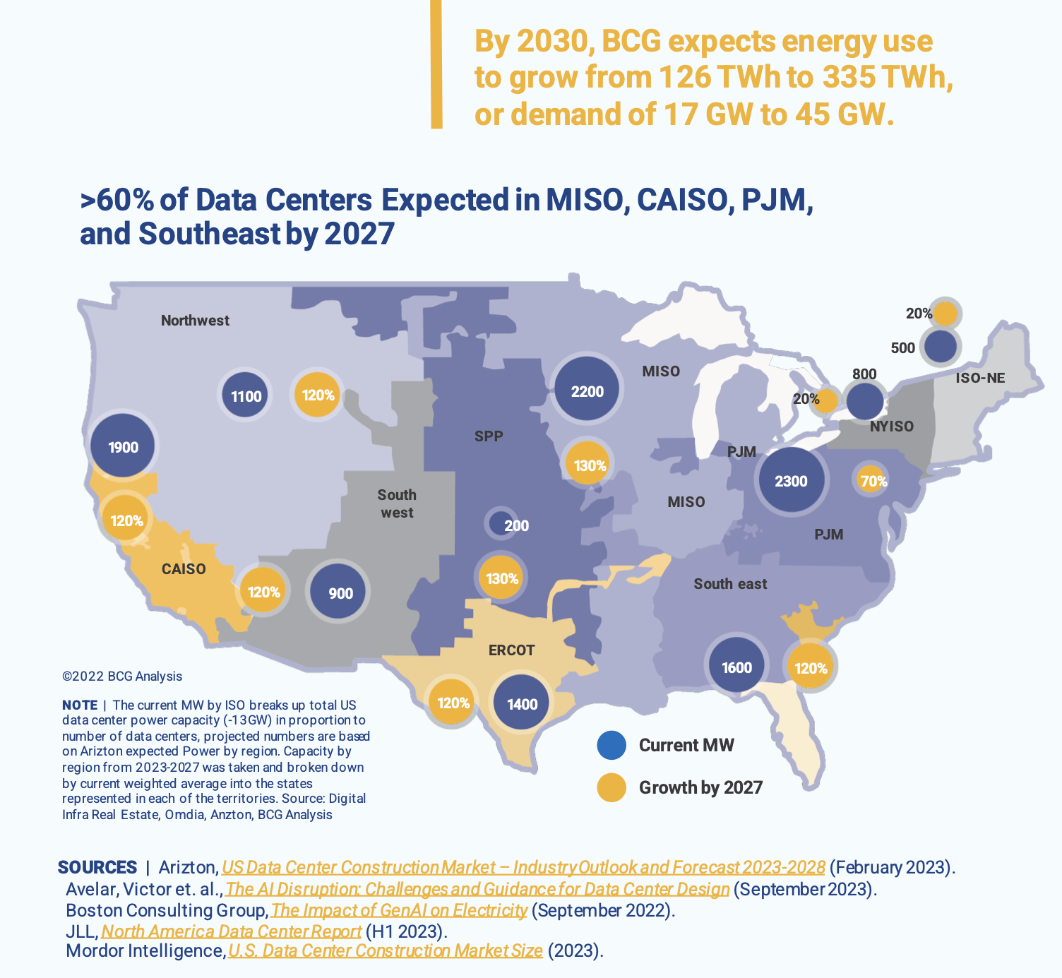
FERC Form 714:
nationwide power
demand to grow
4.7% over the next
five years

Slide 6
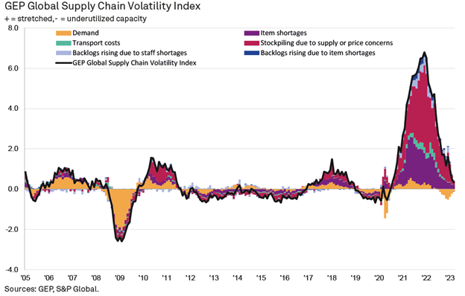
Notes:
GEP Global Supply Chain Volatility Index continues its descent as supply conditions improve. The index’s demand component has trended upwards since Dec ’22, suggesting vendor order books are stabilising after a period of aggressive inventory drawdowns. supply chain sustainability is becoming a core business priority. Companies are reimagining supply chains to build resilience, boost transparency and beat disruption.

Slide 7
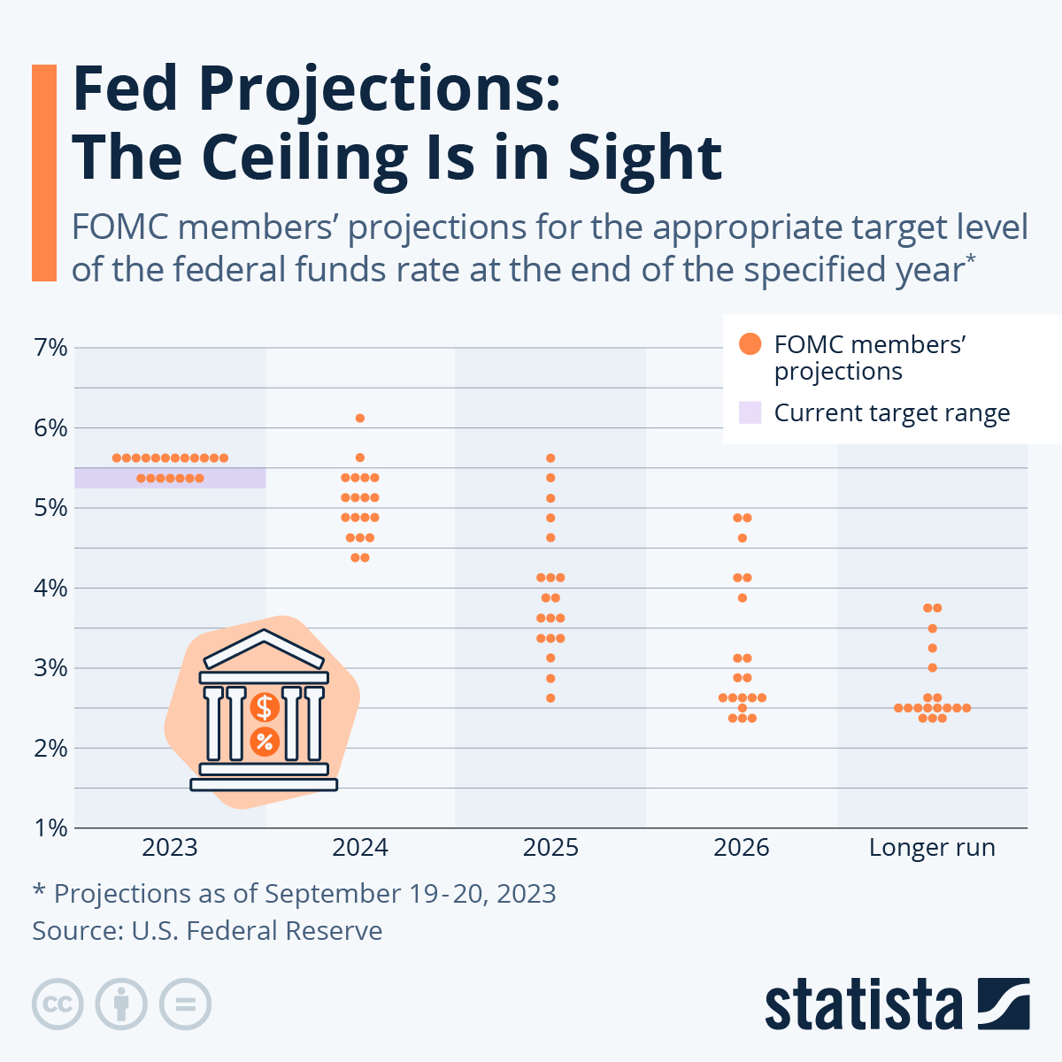

Slide 8
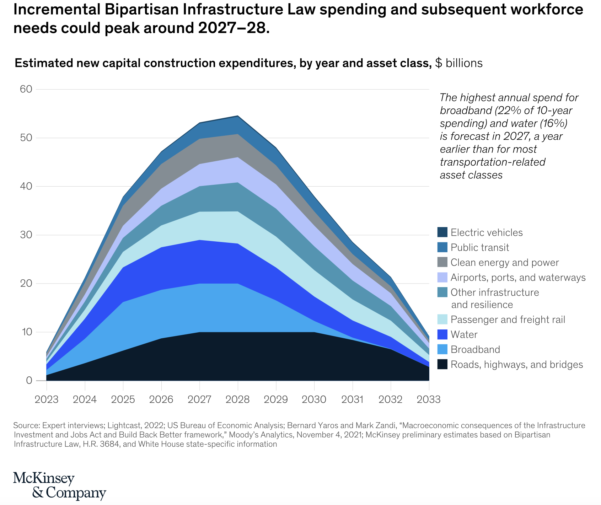

Slide 9
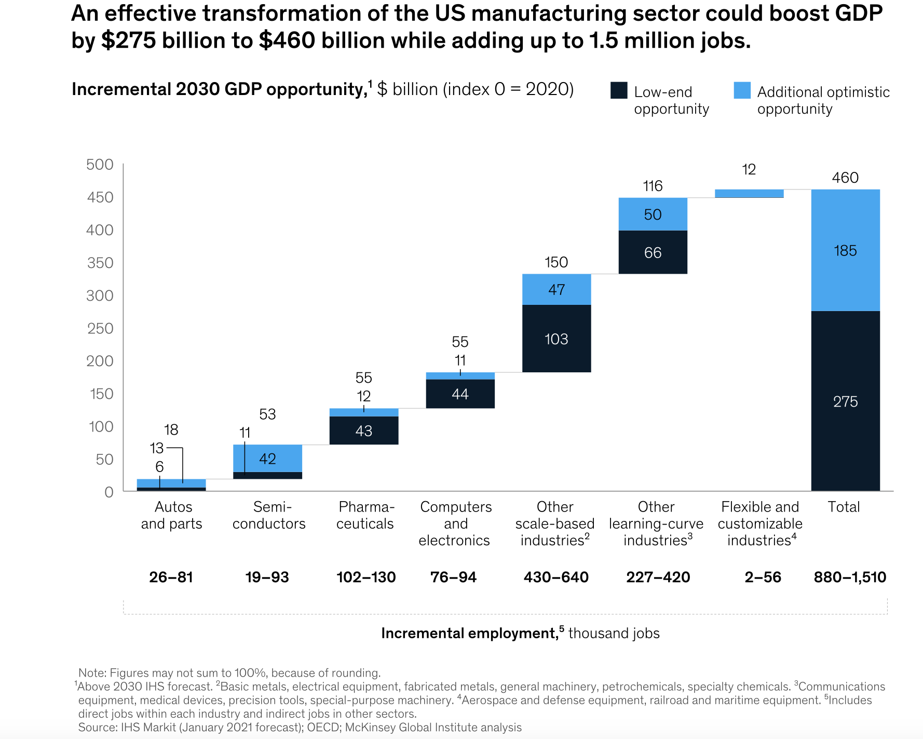

Slide 10
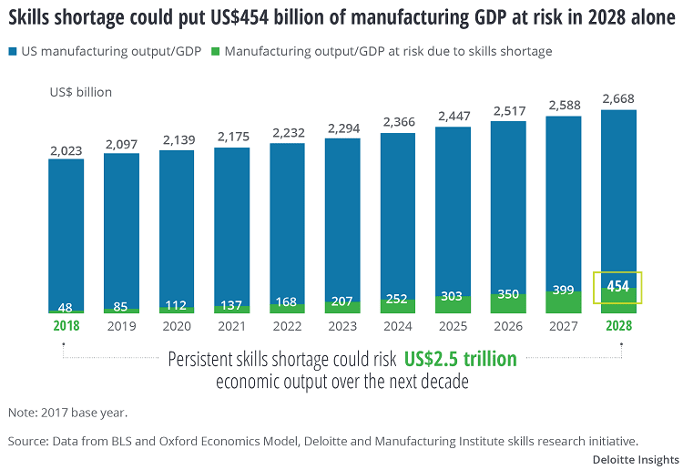
Notes:
Applications of AI and Automation within Industrial Settings
The US currently has a net deficit of 1.5M frontline manufacturing workers, the notion of reshoring and nearshoring is elegant as a talking point but the reality is that we do not have the labor capacity to support our production and output targets

Slide 11
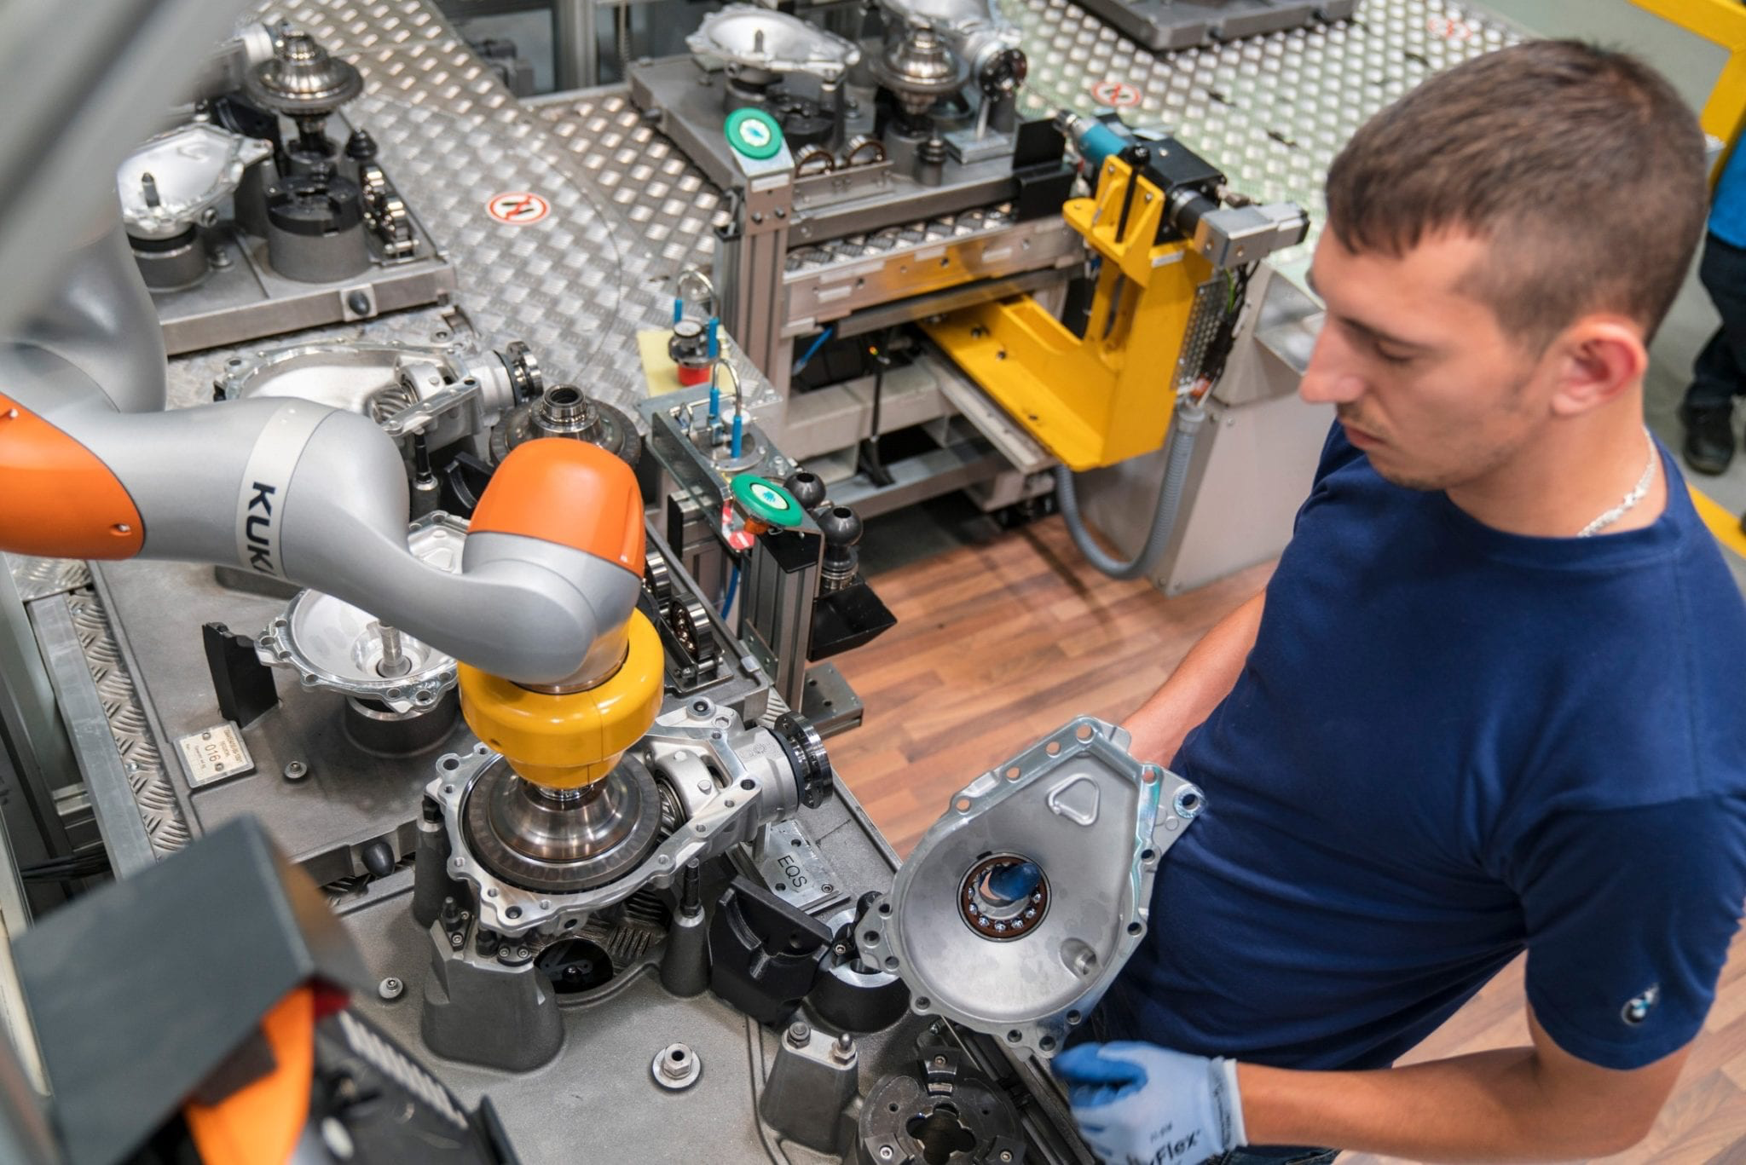

Slide 13
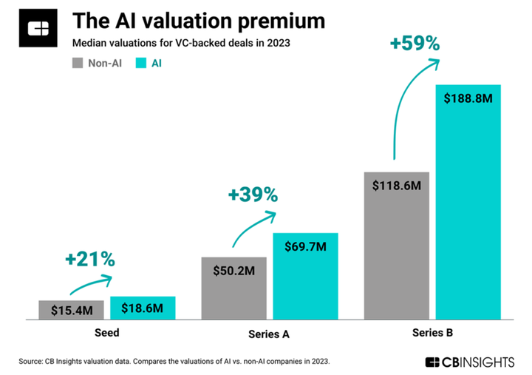

Slide 14
Notes:
In all four quarters of 2023, more than 19% of new funding rounds came at a lower valuation than the company’s previous round. Those are far and away the four highest quarterly rates the market has seen since the start of 2018.
This new normal has been an adjustment for founders and investors alike. Many had grown used to a funding environment where valuations could generally be expected to proceed in an orderly fashion up and to the right. Instead of a relative rarity, down rounds were a common feature on the startup landscape in 2023.

Slide 15
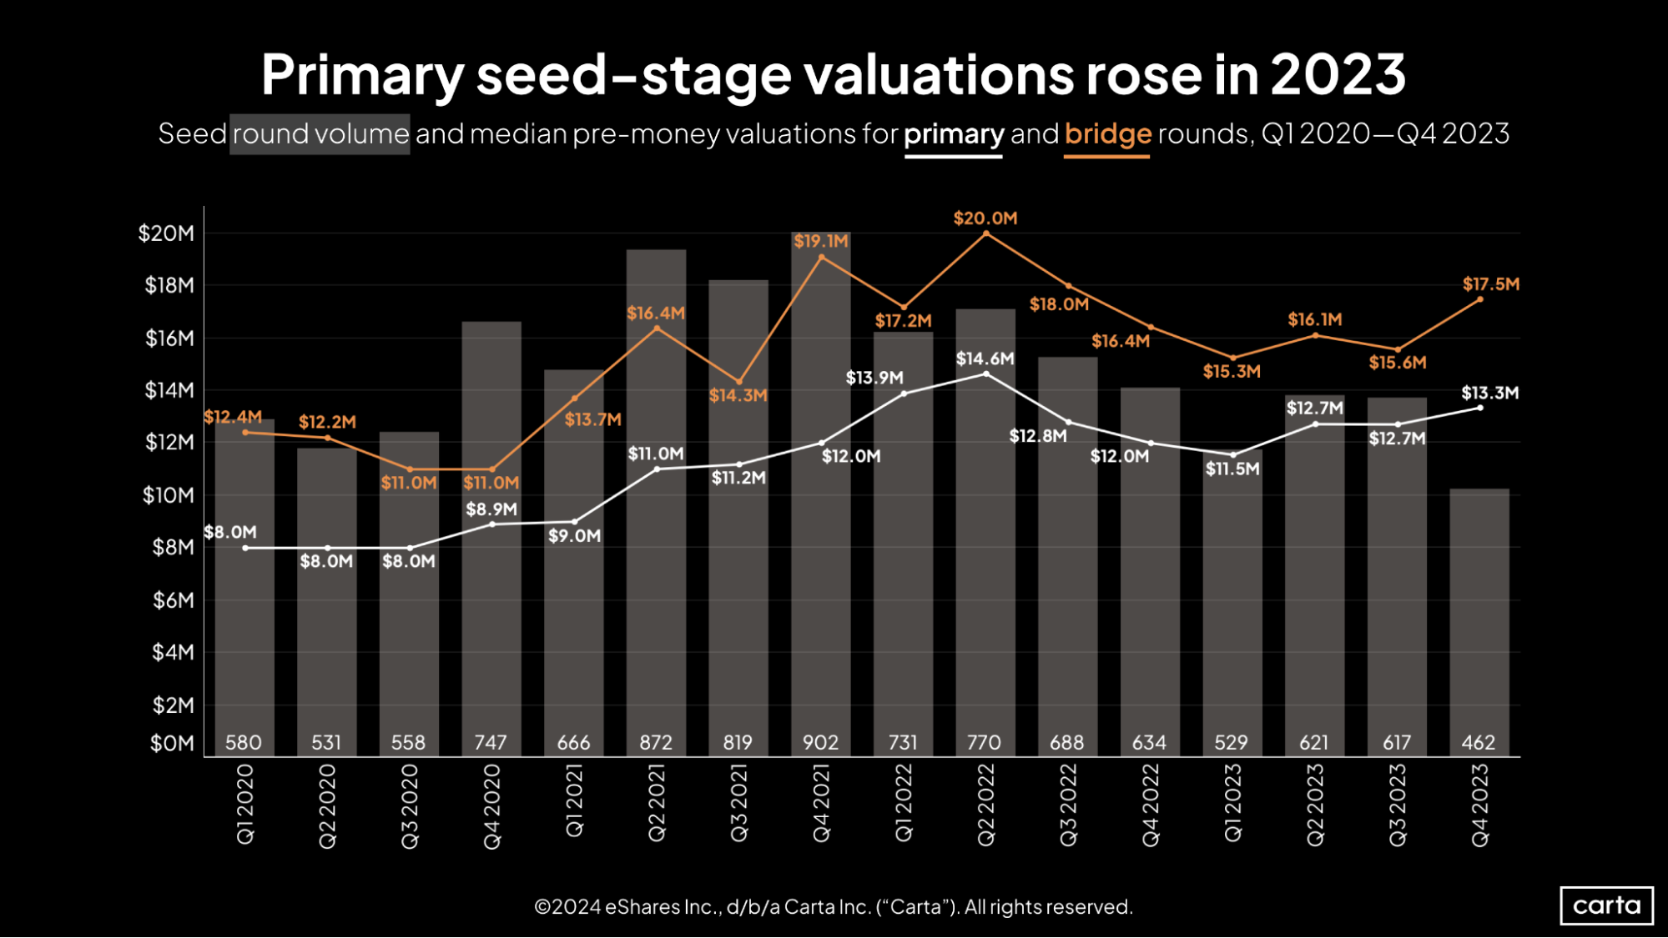
Notes:
While deal count took a notable dip at the seed stage in Q4, the median pre-money valuation on primary funding rounds continued to climb, reaching $13.3 million. That’s the third-highest quarterly median so far this decade. There were ups and downs in 2022, but on a longer timeline, the median seed valuation on primary deals has been trending steadily upward for the past four years.
The median valuation on bridge rounds raised by seed companies also jumped in Q4, reaching $17.5 million. Seed is the only stage where the median bridge valuation has been higher than the median primary valuation in every quarter since the start of 2020.

Slide 16
Notes:
The median pre-money valuation on primary Series A fundings was $44 million in Q4. Just like at the seed stage, this was the third-highest quarterly median since the start of 2020. After staying flat around $35 million for several consecutive quarters, valuations have now grown significantly over the past two quarters.
The recent history of Series A bridge valuations has been more volatile, including a 25% quarter-over-quarter increase in Q4. About 45% of all Series A fundings in Q4 were bridge rounds, the highest rate on record.

Slide 17
Notes:
In Q4, the median time between a company’s Series A and its Series B extended to 784 days (about two years and two months), the longest interval on record. In general, the time between rounds has been trending up in recent years at Series A, Series B, and Series C. For founders, ensuring your startup has enough runway has never been more important.

Slide 18
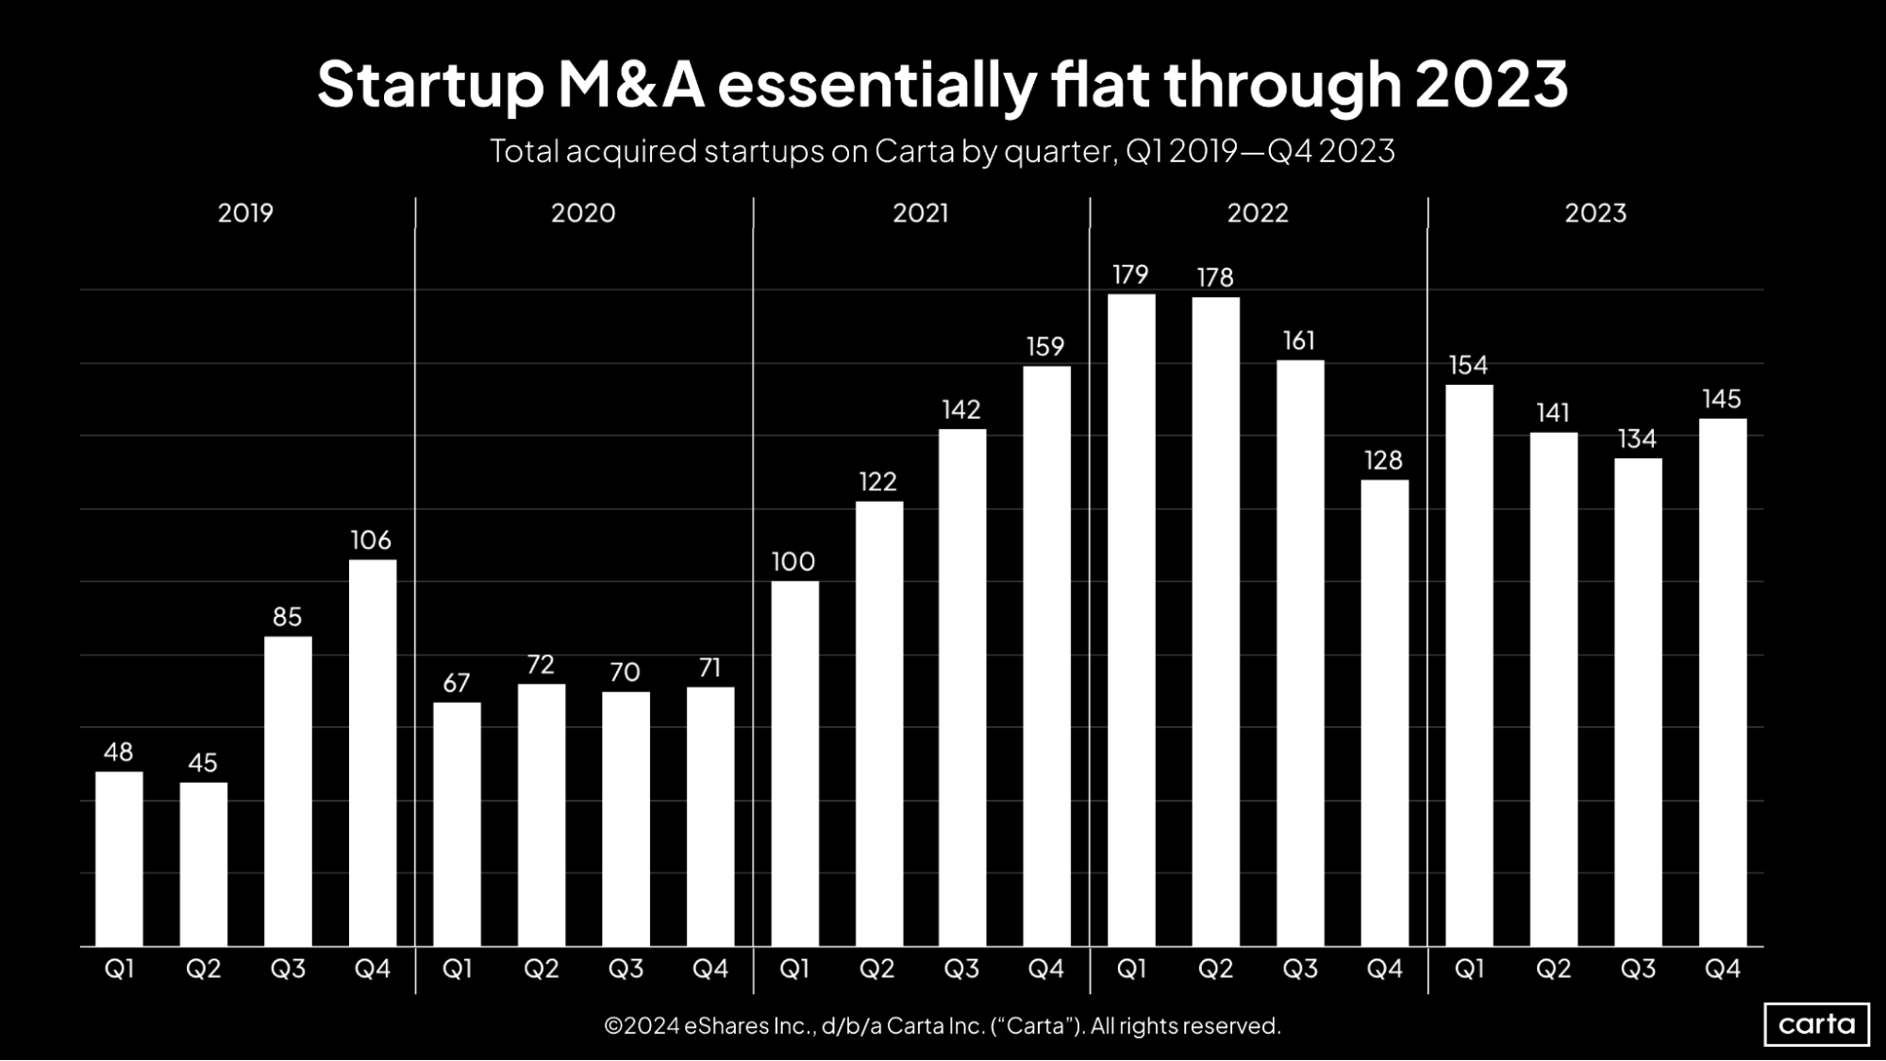
Notes:
The number of startups exiting through M&A mostly stayed steady throughout 2023, ending the year with 145 transactions in Q4. For the full year, companies on Carta were the target in 574 M&A deals, down about 11% from 2022. Compared to IPOs—the other primary exit pathway for venture-backed startups—the M&A market has stood up quite well amid a cooler dealmaking market.
Still, it was a relatively quiet year for M&A activity across the broader corporate landscape, as would-be buyers grappled with high interest rates, geopolitical uncertainty, and other variables.

Slide 19
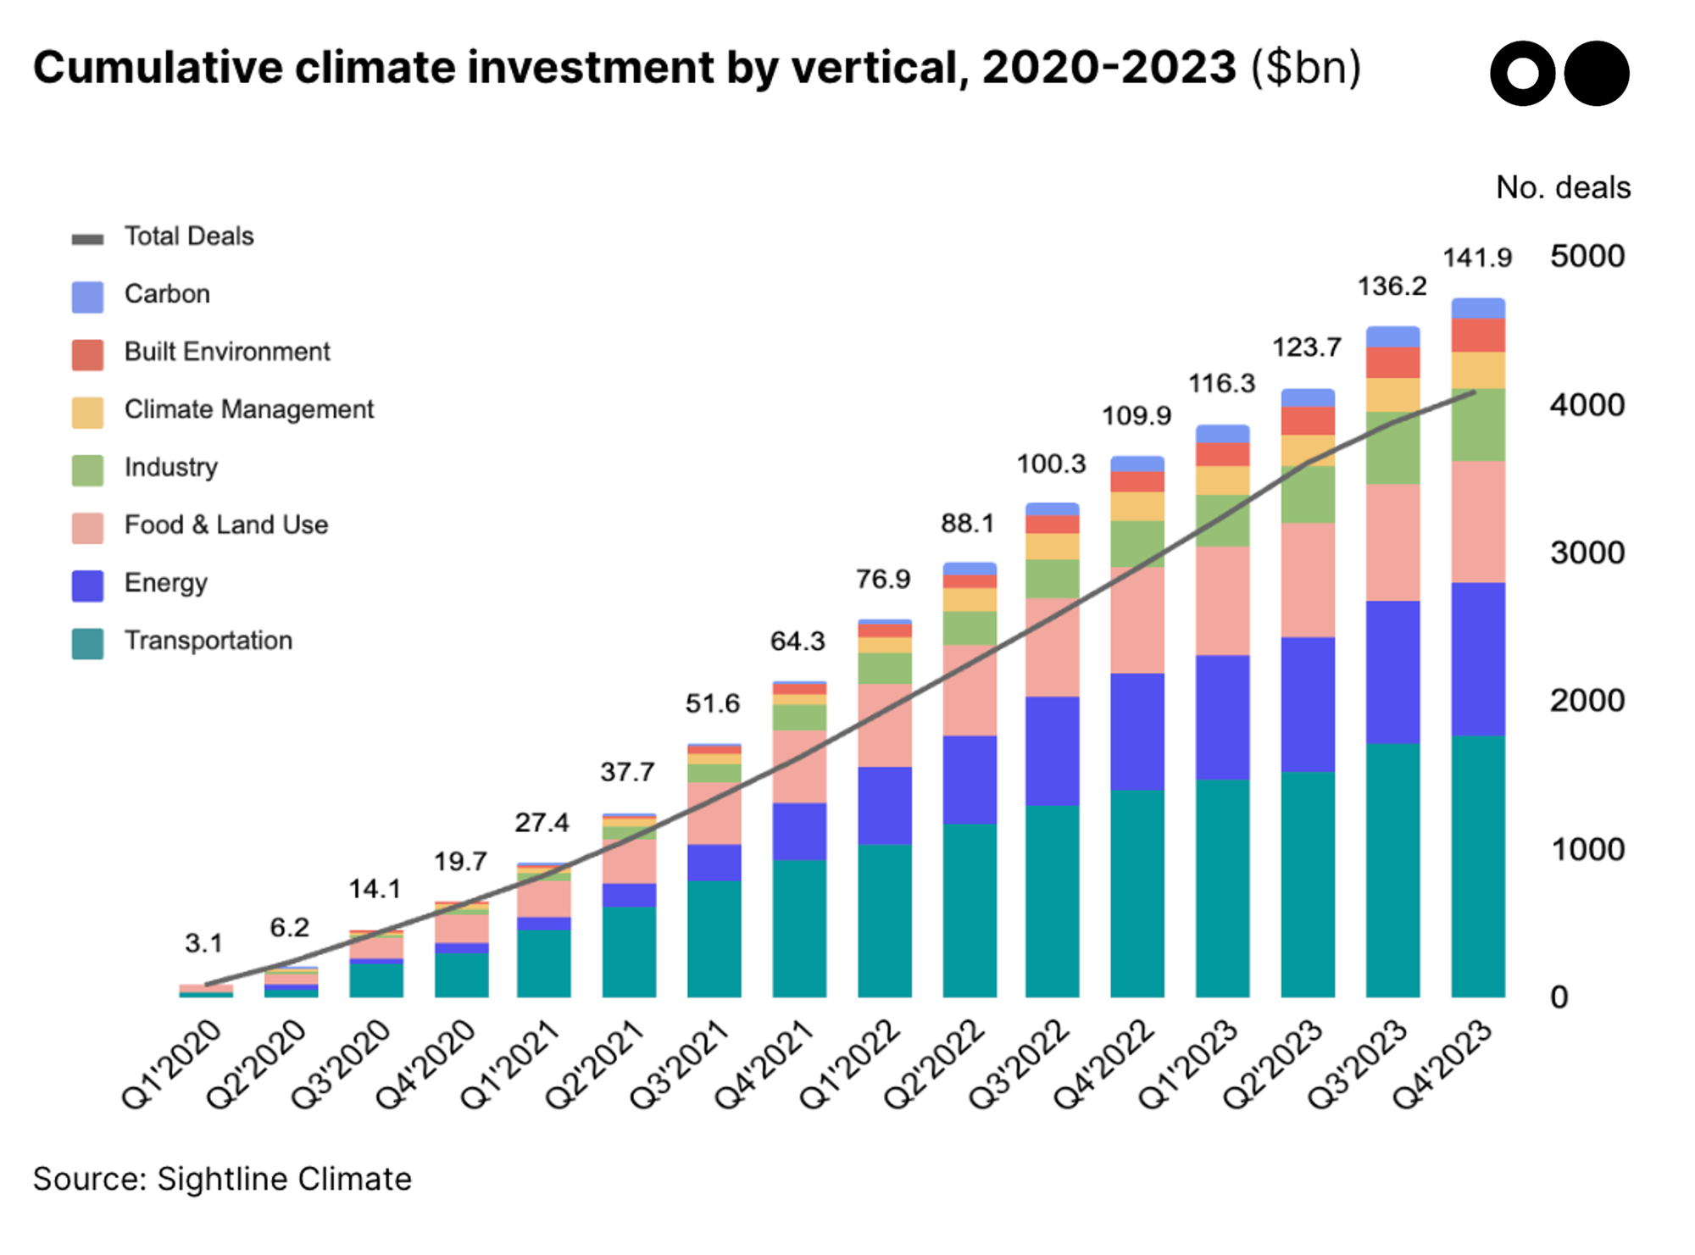

Slide 20
