Slide 1
Scaling Innovation
Creating a Portfolio-Based Approach to Project Finance
A discussion on how project finance mechanisms should approach portfolio wide opportunities for clean energy development

Slide 2
GridMarket Executive Summary
Solution
Target Market
A technology-agnostic clean energy platform to help facilities identify, install, and optimize projects
Large energy consumer portfolios - manufacturing facilities, logistics/transportation, cold storage, etc.
Business Model
Success
No risk opportunity assessments with ongoing support paid through a success fee
Fortune 500 and 1000 customers contracted and in pipeline; globally operational projects with diverse technology mixes

Slide 3
2+
5+
750+
Trillion
Gigawatts
Million
DATA POINTS PROCESSED THROUGH THE GRIDMARKET PLATFORM USING AI/ML
LISTED SOLAR PV, BATTERY STORAGE, EV, FUEL CELL, AND MICROGRID DEALS
PROPERTIES PREQUALIFIED FOR CLEAN ENERGY OPPORTUNITIES

Slide 4
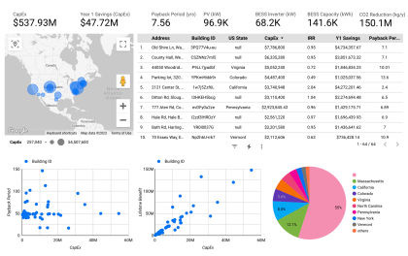
Portfolio-Level Energy Insights
Portfolio customers often have different types of projects across all opportunities - from utility scale solar to onsite microgrids to efficiency and ev charger installations. We see it all. And we see the challenges customers face to secure appropriate financing.

Slide 5
Renewable energy project finance models are fragmented and outdated.

Slide 6
Creating an integrated portfolio approach
Scaled solutions produce the greatest value
Portfolio opportunities exist across different properties and different markets
Projects within a portfolio can often be held up by financing challenges as the investment market cannot holistically meet all project needs

Slide 7
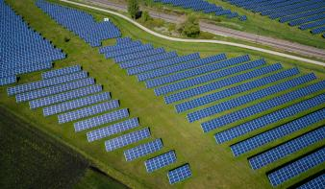
Portfolio Client Case Study
Client: national logistics provider with varying opportunities in different markets
Texas Utility Scale Solar
Ohio Solar Ground Mount and Carport
California Solar, Battery Storage, EV Chargers

Slide 8
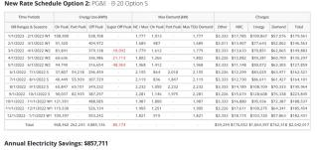
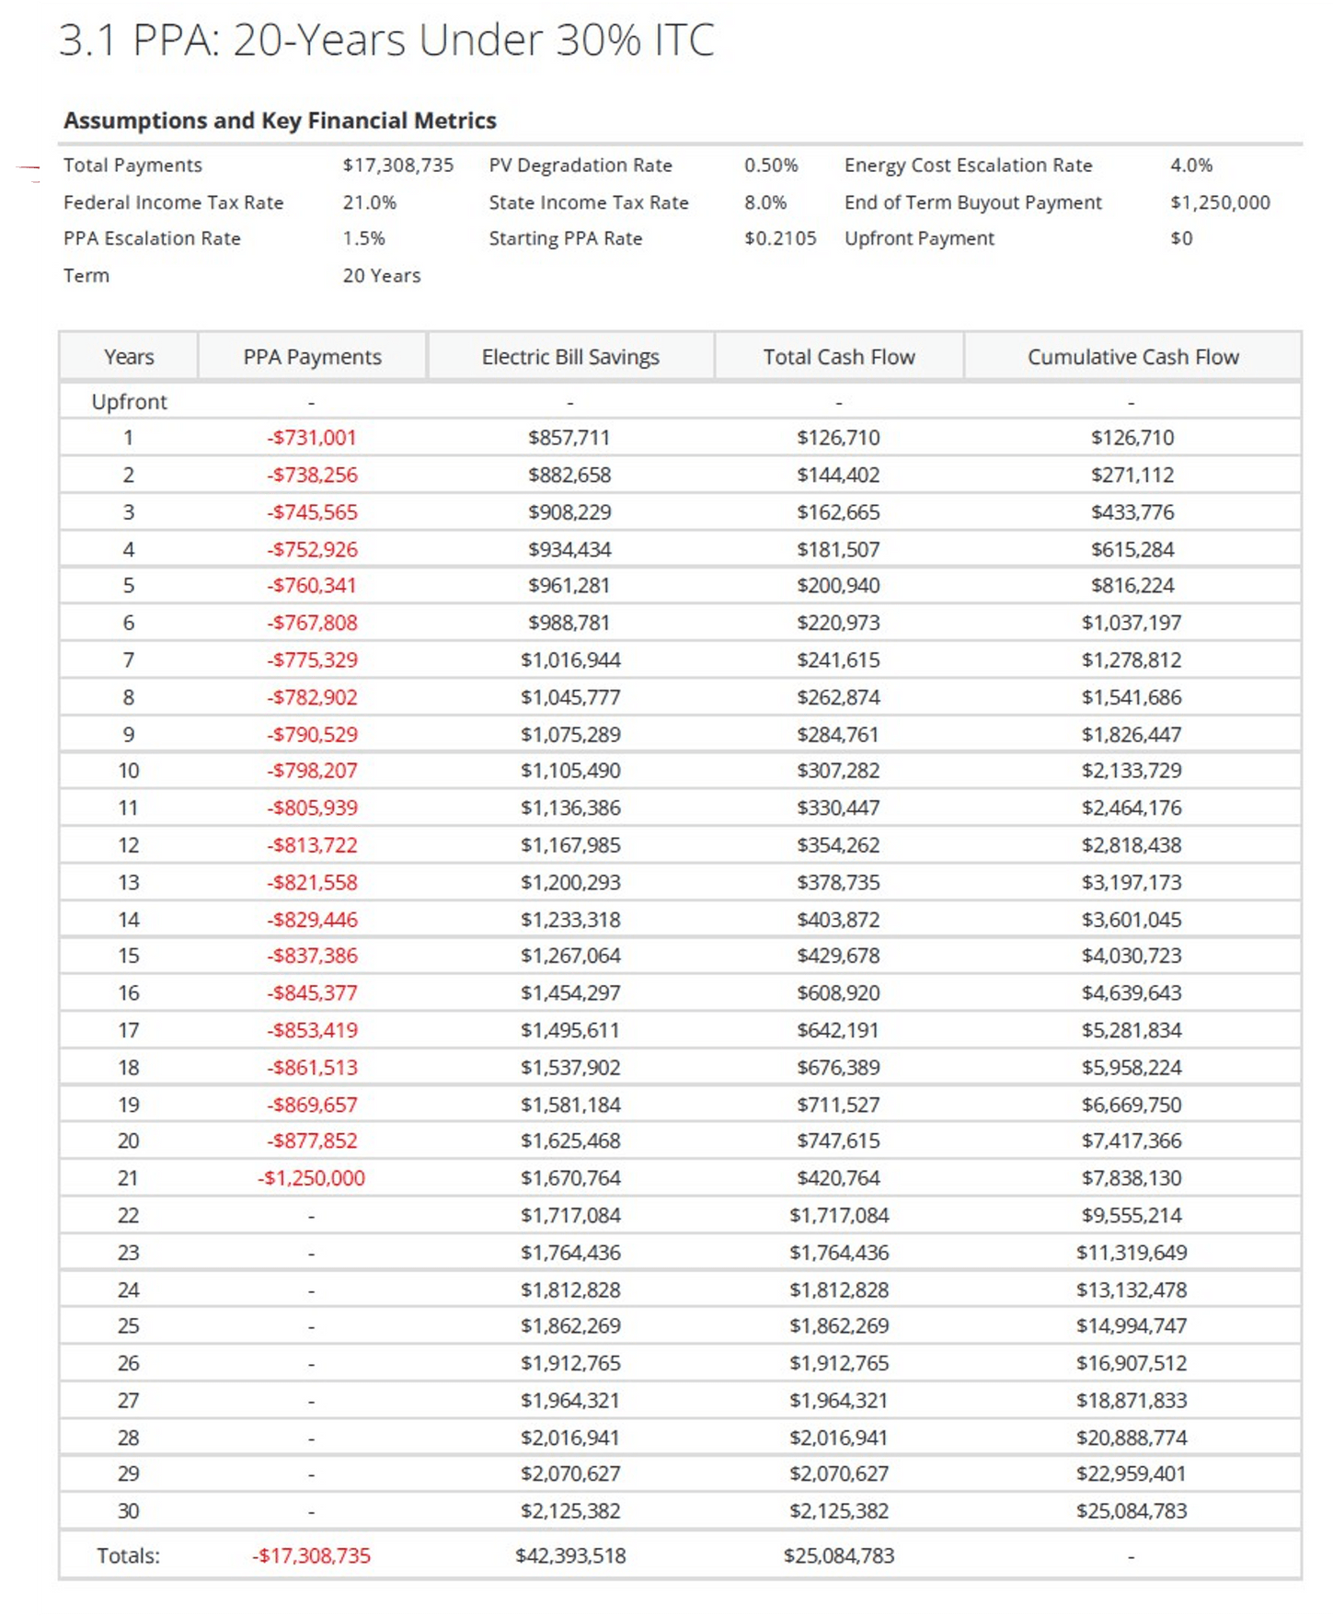
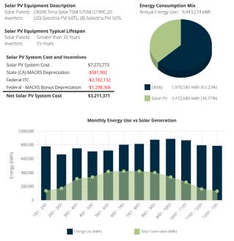
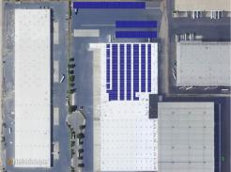
Solar
Storage EV Chargers
In-Depth Example Project Opportunity

Slide 9
REIMAGINING PORTFOLIO-BASED FINANCE STRATEGIES
A data-driven, AI-based approach allows us to bridge the gap and assess the value and risk of coupling different project types together and allow us to better see how to finance

Slide 10
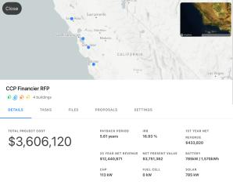
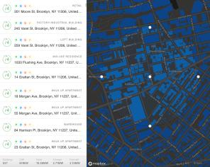
Data and AI For Portfolio Finance Evaluation
Visualize, Quantify, and Innovate
Targeted Portfolio Opportunity Review
Data Driven Decision Making
Customized Search and Filter Tools

Slide 11
Thank you
Want to talk portfolio-wide project finance opportunities?
So do we.
Nick Davis
CEO
nick.davis@gridmarket.com

