Slide 1

Energy Storage and Solar
Wall Street Green Summit 2024
Desmond Wheatley
President and CEO
Beam Global
BeamForAll.com

Slide 2
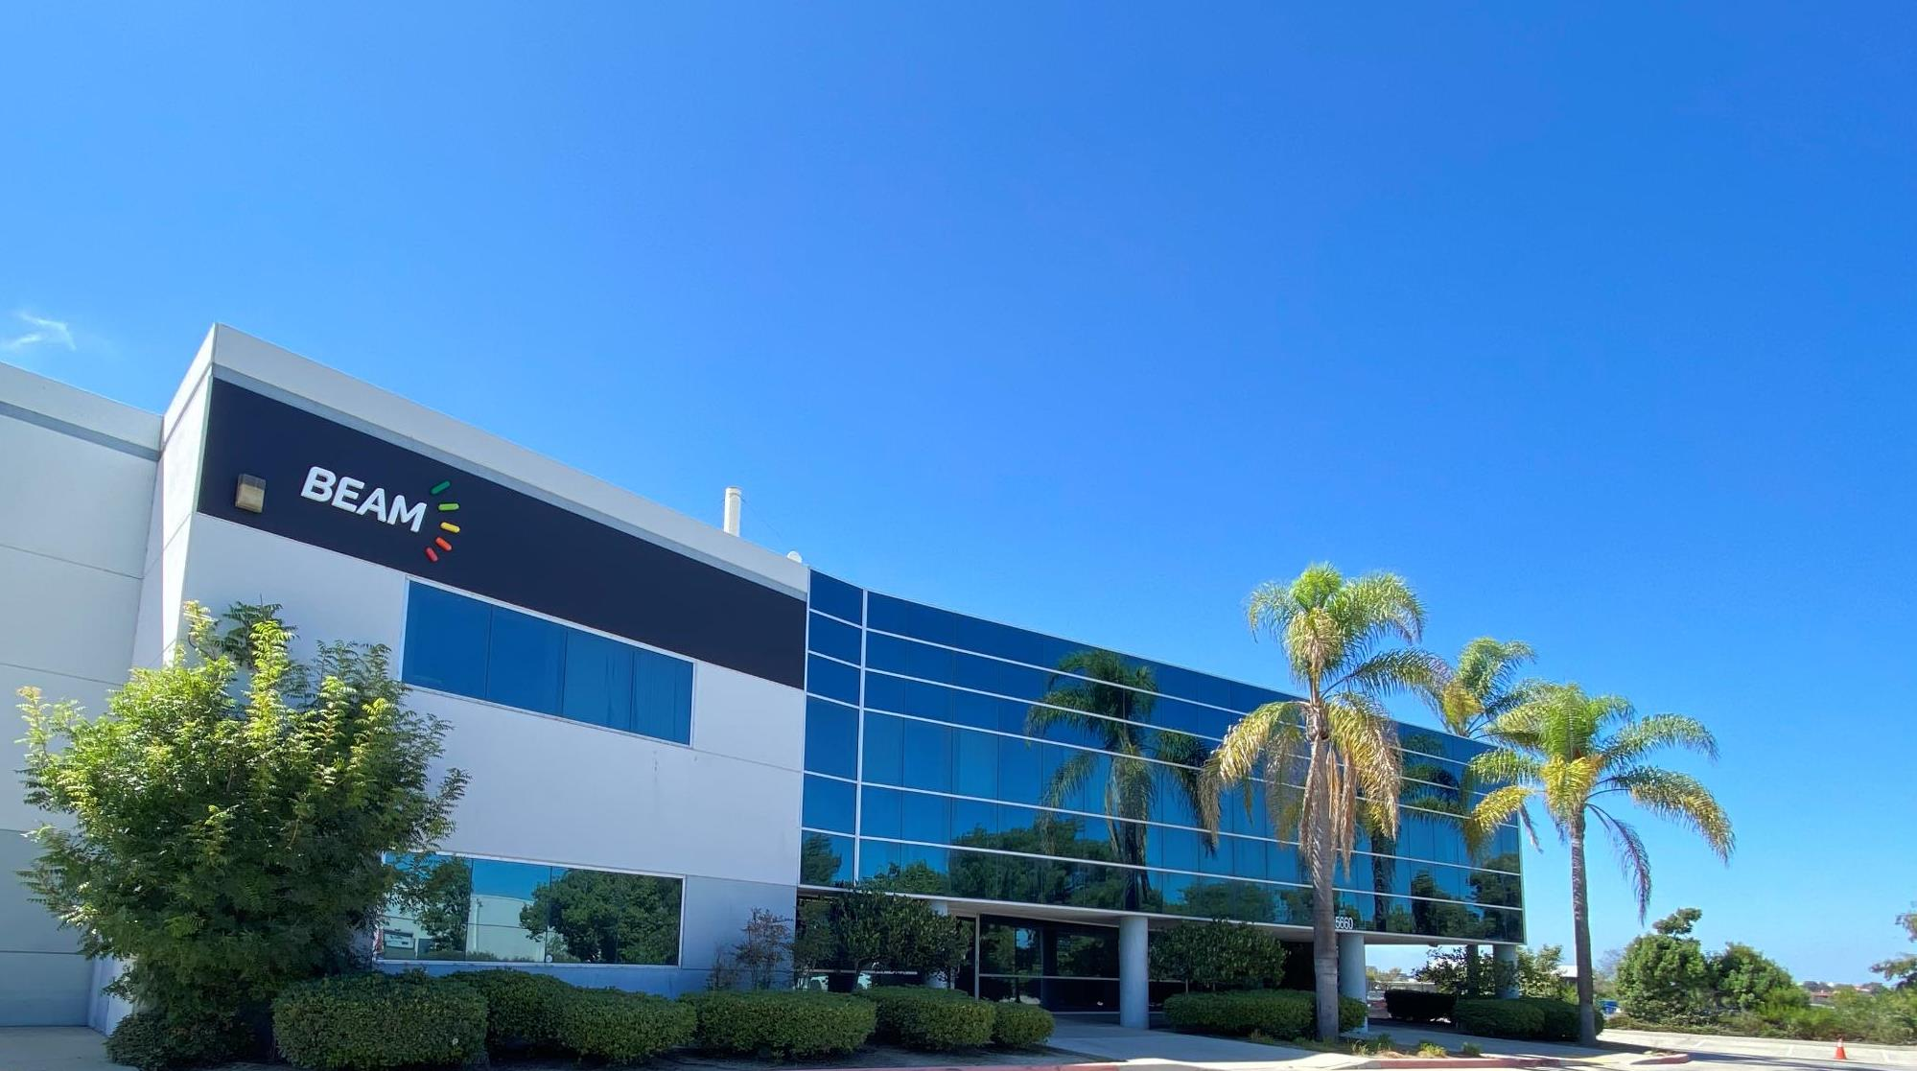

Founded in 2006
Publicly traded (Nasdaq: BEEM)
Sustainable technology innovation company
EV charging, energy storage, energy security
Products manufactured at our San Diego headquarters, in Chicago IL and in Europe
Products invented and made in America

Slide 3
Clean Mobility Core Offerings
ENERGY STORAGE
    Custom Battery Partner: design, testing, production
    Off-the-shelf modular battery solutions
    Micromobility, aviation, maritime, stationary, industrial
    Patents for superior safety, longevity, power density
EV CHARGING
    Off-grid solar EV charging infrastructure and systems
    Rapid deployment in minutes not months
    Transportable and permanent solutions
    Powering electrification of transportation with renewable energy
ENERGY SECURITY
    Off-grid solutions
    Resilient sources for electrification of transportation
    Power in natural disasters, emergencies, grid outages
    100% renewable energy source

Slide 4
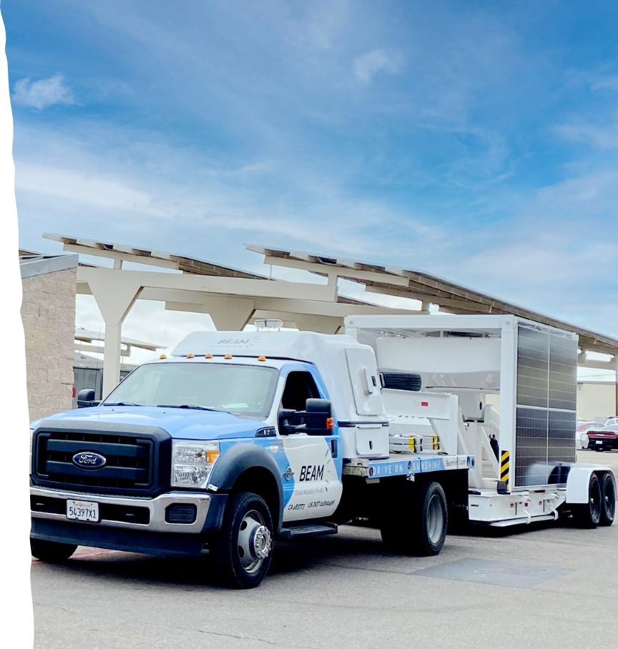


Scalable EV Charging Infrastructure with shortest deployment time
    OFF-GRID EV CHARGING
    1 HOUR
GRID-TIED EV CHARGING DEPLOYMENT TIME
NEW YORK CITY
CALIFORNIA
24 MONTHS
18 MONTHS
EV ARC™ stowed for transport on ARC Mobility™ trailer

Slide 5
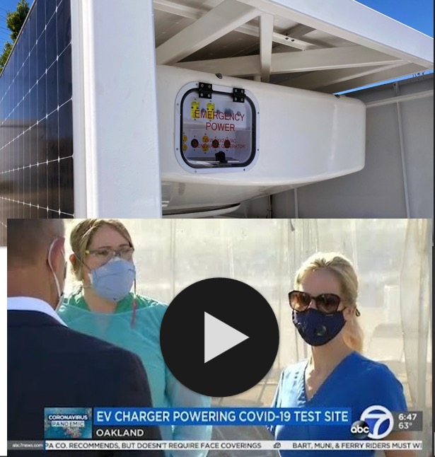
WHY WE FOCUS ON:
Energy Security
    Grid interruptions cost US businesses ~$200B a year
    Grid vulnerability is increasingly viewed as a strategic vulnerability by the US military and Federal, State and Municipal Governments
    The global back-up power market is expected to total $19.4B in 2021, growing at a CAGR of 4.6% from 2017 to 2021
    Fleets that are electrified will need a source of power that is not vulnerable to grid interruptions to avoid grounding their fleets
    Beam Global customers like US Army, USMC, NYC are buying EV ARC™ products as a hedge against blackouts
Video of News Coverage
https://youtu.be/YB2V9WSv0QQ

Slide 6




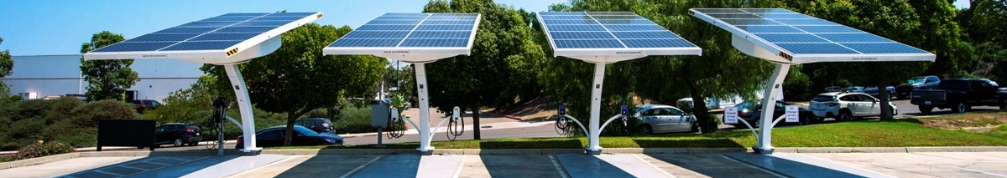
Infrastructure Products That Support Any Quality Brand of EV Charger
    Rapid and scalable deployments
    No permitting required
    No construction required
    No electrical work required
    No grid connection required
    No utility bill
    No vulnerability to blackouts
Beam Global products are powering…
…and many other quality EVSE brands

Slide 7
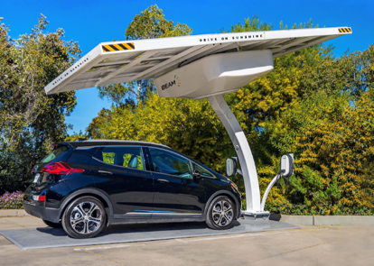
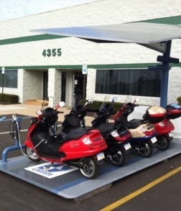
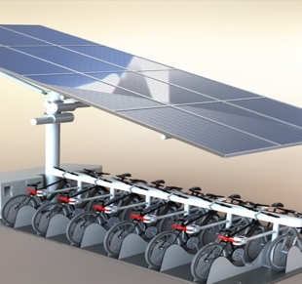
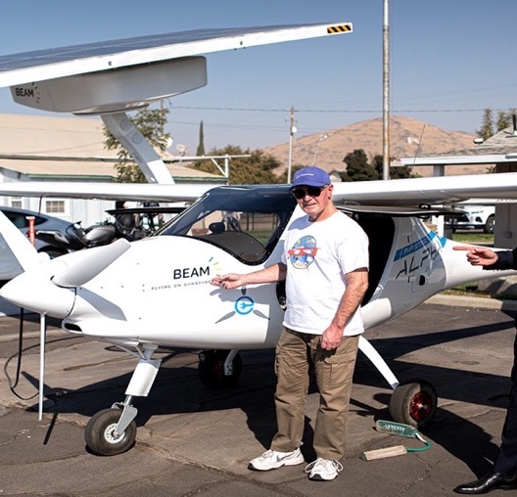

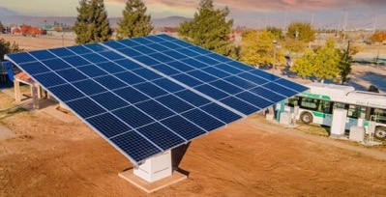
Infrastructure Products That Charge Any Type Of Vehicle
Bigger TAM than typical EV charging company as a result
NASDAQ: BEEM,BEEMW
7

Slide 8

Ruggedized for Extreme Environments
EV ARC™ Systems Deployed on
US Marine Corps Bases
NASDAQ: BEEM,BEEMW

Slide 9

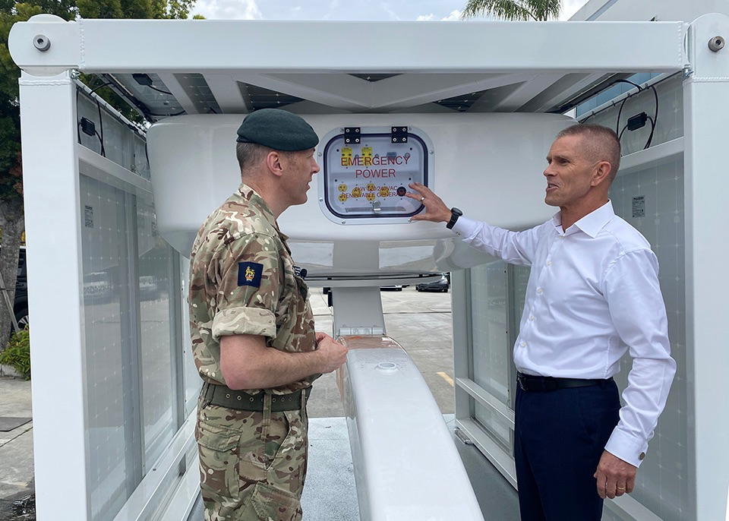
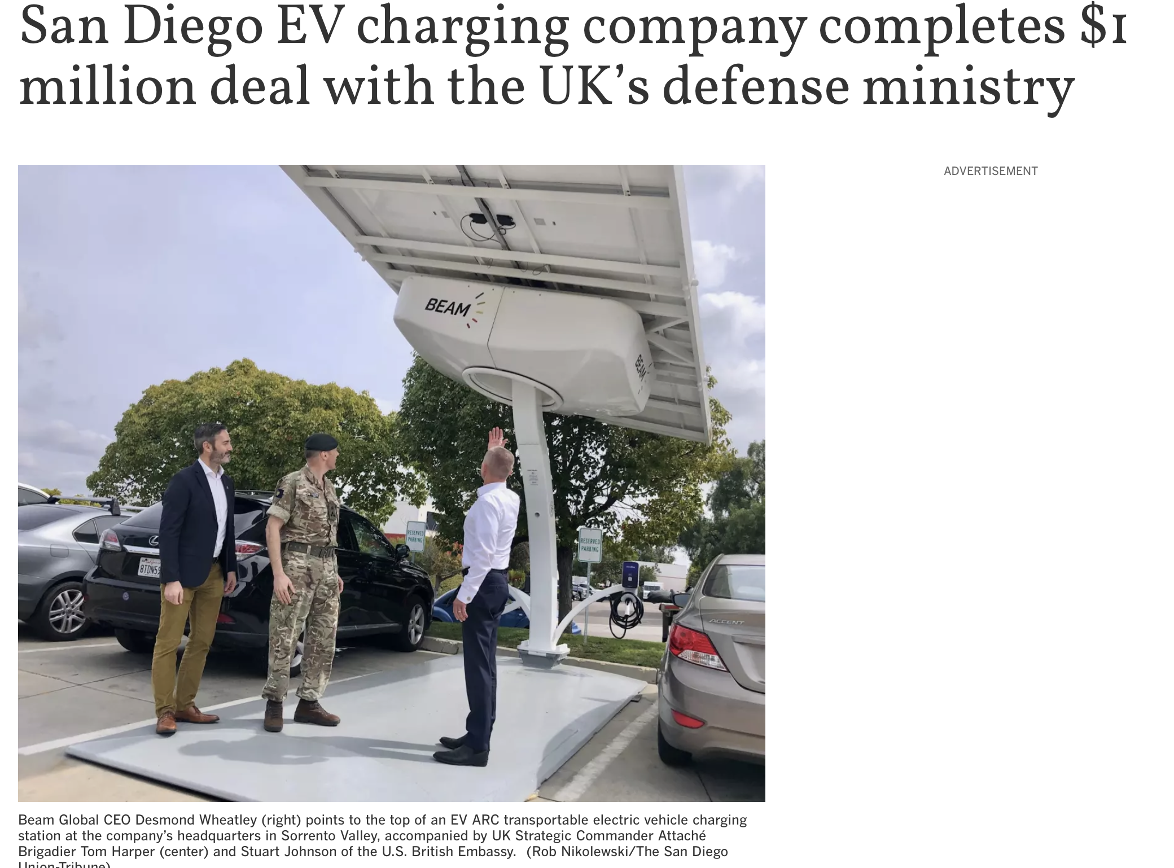
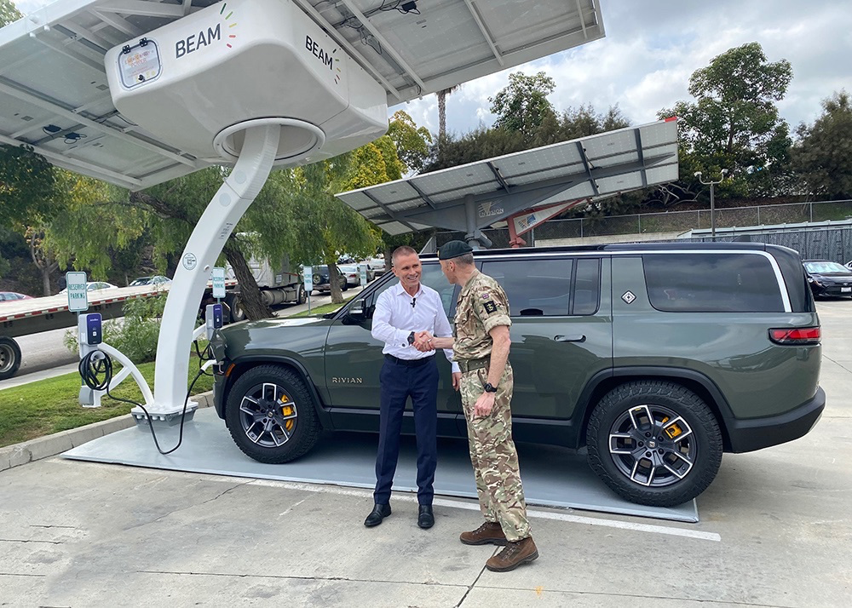

Slide 10
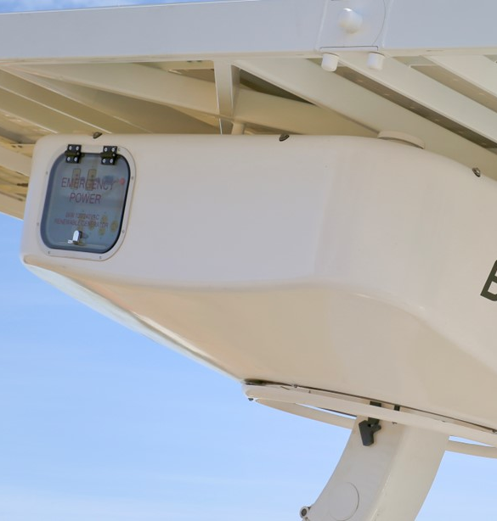
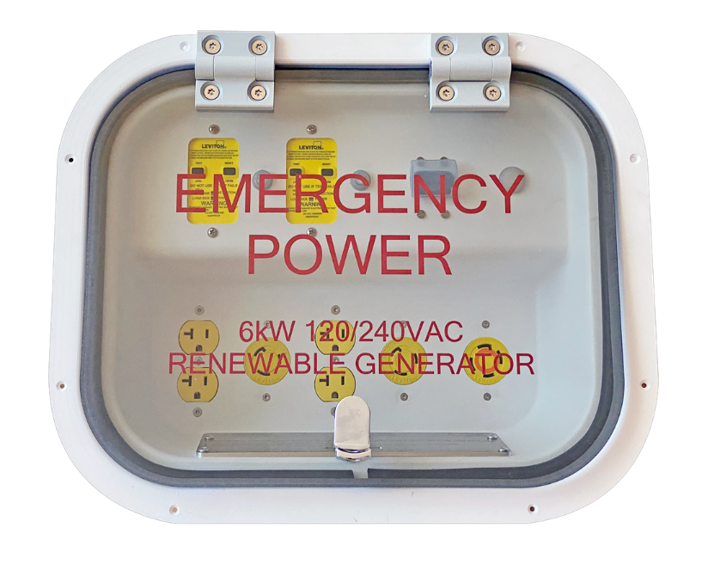
EV ARC™ 2020
Off-Grid Emergency Power
Energy when and where you need…
    Charge during blackouts, utility outages, weather events
    Relocate to high-risk locations, hospitals, shelters…
    Wind-rated up to 125 mph
    Flood-proof up to 9.5 feet
    Working asset during emergencies
    Integrated emergency power panel

Slide 11
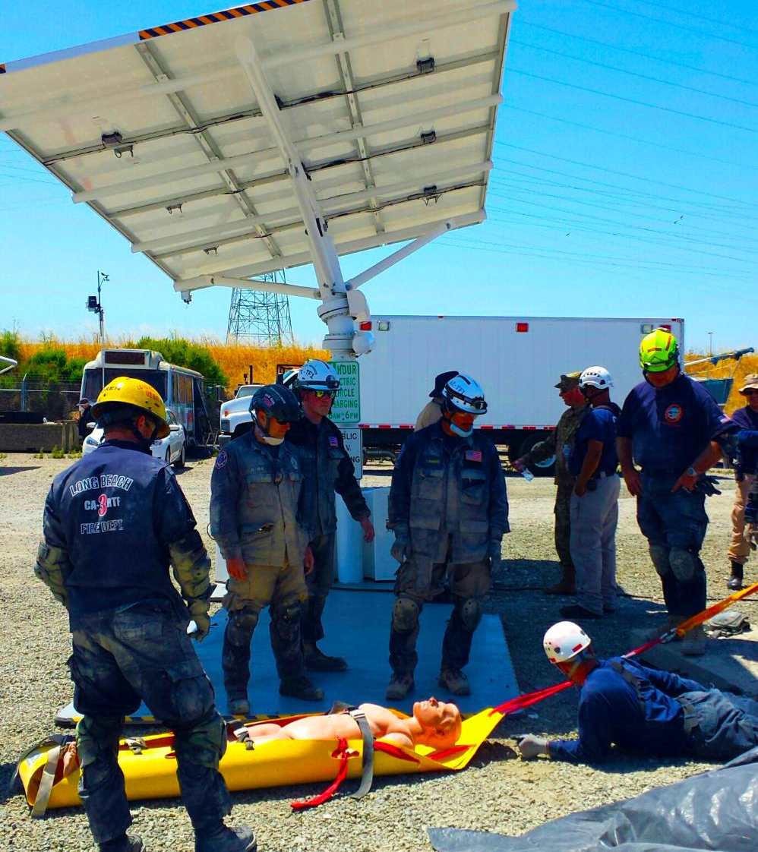
Emergency Preparedness for First Responders
EV charger becomes a lifesaver
    Generators sit idle in storage most of the time
    Renewable power: No refueling
    Clean power: No toxic emissions
    Quiet power: No disruption for medical staff or patients
    Safe power: No volatile fuel to transport or store
    Resilient: No vulnerability to grid outages
    Included in FEMA's Authorized Equipment List (AEL)*
* Beam Global EV ARC™ solar-powered charging stations are included in the FEMA Authorized Equipment List, under designation 10BC-00-SOLR Chargers.

Slide 12





Beam AllCell™
Energy Storage Solutions
Patented thermal management technology for superior safety
Battery packs optimized for each product’s unique format needs
Rapid recharge capability for high utilization environments
Excellent performance in extreme temperatures
Highly flexible battery platform architecture
Ideally suited where safety, energy density and custom enclosures require high power in small spaces.
Cool by Design

Slide 13






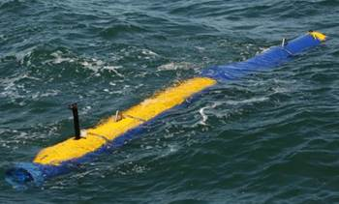

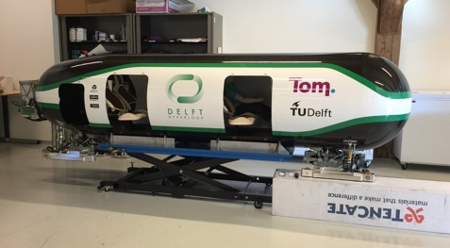
Markets We Specialize In
GROUND MOBILITY
Micromobility
NEVs/light EVs
Recreational and sport
Auxiliary power units
AVIATION
UASs/drones
Med-Large format UAVs
eVTOL
Auxiliary power units
MARINE
Recreational watercraft
Commercial watercraft
UUVs/USVs
Auxiliary power units
INDUSTRIAL
    Material handling
    AMRs, AGVs, Robotics
    Commercial equipment
    Stationary/grid storage
Some photos are actual customers; some photos are for illustration purposes

Slide 14
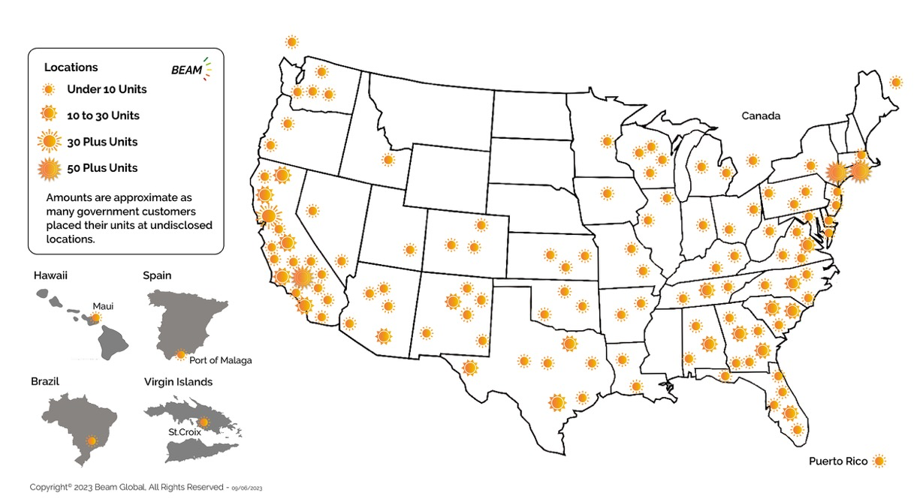
Hundreds of Beam Global EV Charging Products Deployed
Municipalities
State Agencies
Federal Government
Fleet Operators
Workplace Charging
Public Charging
Businesses
Military
NASDAQ: BEEM,BEEMW

Slide 15
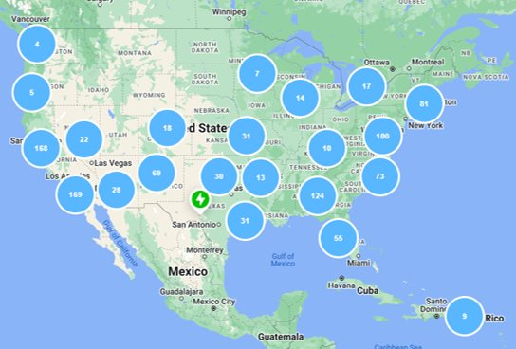

1450 EV ARC™ Operating in Diverse Climates, Nearly 1 Million
Operating Days and no Other Incidents
1450 EV ARC deployed all over North America
  From Northern Minnesota to the deserts in Arizona and New Mexico
    ~20% in colder regions including NY, MI, NJ, MA, PA, WI, ID, WA, CO
    ~40% in hotter regions including Southern CA, AZ, NM, TX, FL
Total Operating Time: 983,254 Days
Average Operating Time: 722 Days

Slide 16
Thank you
Questions?
Beam Team
BeamTeam@BeamForAll.com
Main: +1 858-799-4583

