Slide 1
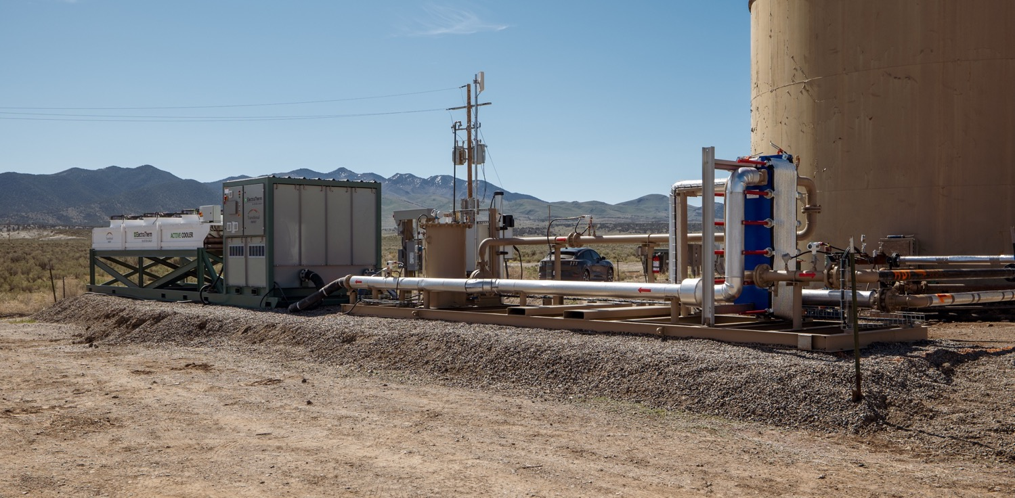
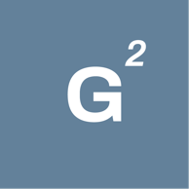
Fossil to Future: Transforming Traditional Energy
Transforming Today’s Hydrocarbon Infrastructure for a Sustainable Geothermal Tomorrow
Dr. Ben Burke
Wall Street Green
March 2024

Slide 2
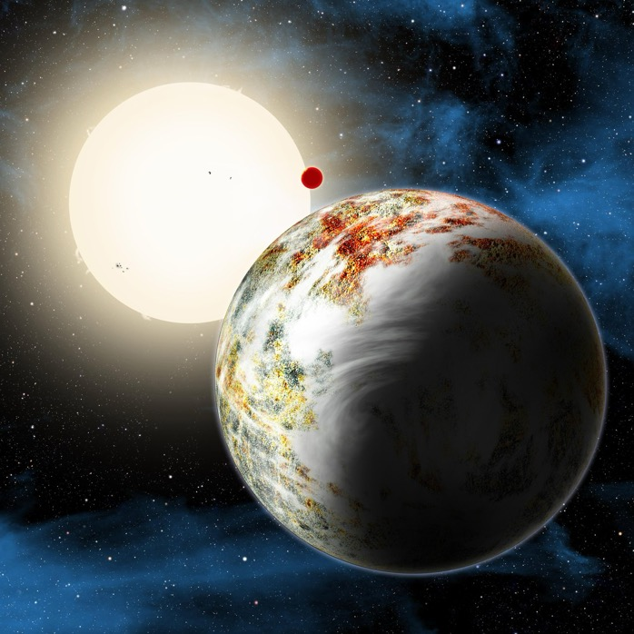
Two Sources of Energy in the Solar System
Radioactive Decay
Solar
Credit: NASA
https://exoplanets.nasa.gov/news/160/mega-earth-messes-with-models/

Slide 3
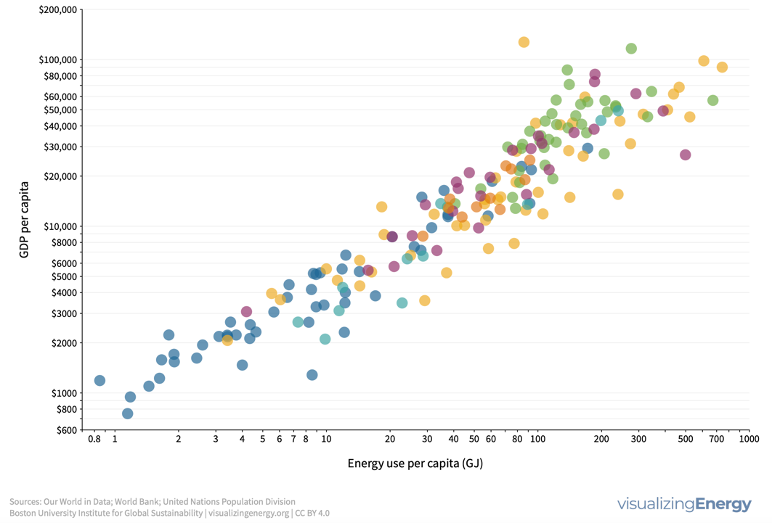
The Energy vs GDP Correlation
https://visualizingenergy.org/what-is-the-relationship-between-energy-use-and-economic-output/

Slide 4
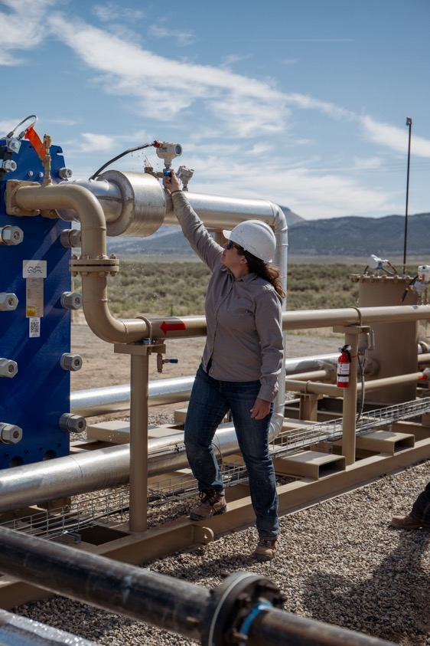
Traditional Energy, Transitional Energy
Pathways for traditional energy in the energy transition:
Connecting the dots from today’s carbon economy to tomorrow’s low-carbon and no-carbon economy
Just transitions for workers
Smart reuse of existing facilities where appropriate
First Installation
Blackburn Field, Eureka County, Nevada Installed April 2022

Slide 5
What Sedimentary Geothermal Looks Like
Proven technology and Proprietary Design
Organic Rankine Cycle Generator (ORC)
Low temperature Organic Rankine Cycle described in 1859
Off the shelf components
Requires minimum 2,000 bfd (4 lps) / 150° F (65° C)
HXC Sled
Proprietary Interconnect to transfer heat from oil field fluid to ORC
Blackburn Field, Eureka County, Nevada Installed April 2022
Pump
Dry Cooler
ORC Generator
HXC Sled

Slide 6
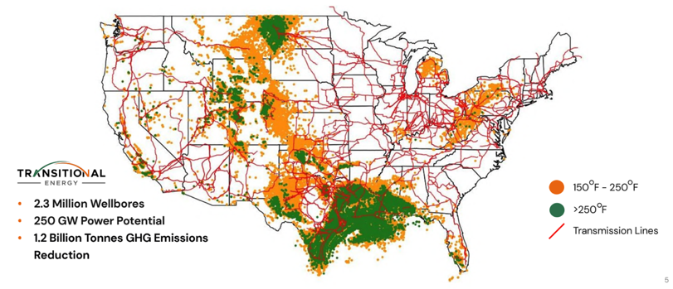
Geothermal: A Pragmatic Approach to the Energy Transition
Millions of Available Sites
 | 2.9M | Oil and gas wells in the US
Massive # of Applicable Wells
 | 520,748 | Suitable for Geothermal Electricity Production⁸
Significant Generation Potential
 | 13GW | Potential Power Generation
Huge Total Market Size
 | $11.4B | Revenue for 13GW @ $100/MWh Current Total Market is $9.1B
Meaningful GHG Reductions
 | 18.2M | Tons of CO2 emissions avoided⁹

Slide 7
Low Temp Geothermal Opportunity
Preliminary and Confidential
Not Geographically Limited and Ready to Scale
Current High- and Medium-Temperature Geothermal Project Locations
Geothermal Sites (USGS)
Available Low-Temperature Geothermal Project Locations
Available Geothermal Resources
High and Medium-Temp Geothermal:
Limited to areas where heat is above 300F
Geographically specific to the West and Southwest Region of the US
Low-Temp Geothermal:
Defined by areas where heat is above 160F
Geographically spread out throughout the US
Corresponds Well to Regions of Oil and Gas Extraction

Slide 8
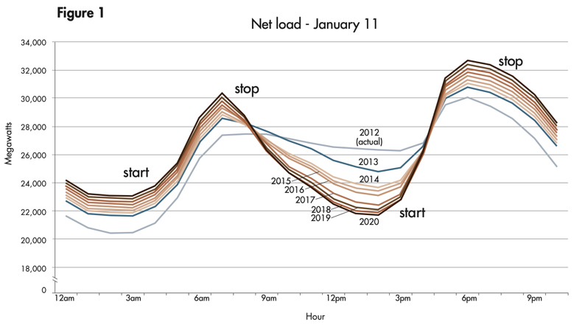
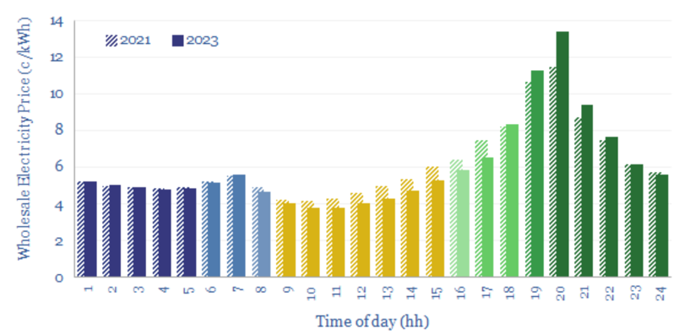
Problem: The Duck Curve
A bigger duck belly means lower
prices on daytime electricity
Source: CAISO
CAISO: https://www.caiso.com/documents/flexibleresourceshelprenewables_fastfacts.pdf
Thunder Said Energy: https://thundersaidenergy.com/downloads/california-electricity-prices-by-hour/
Source: Thunder Said Energy

Slide 9
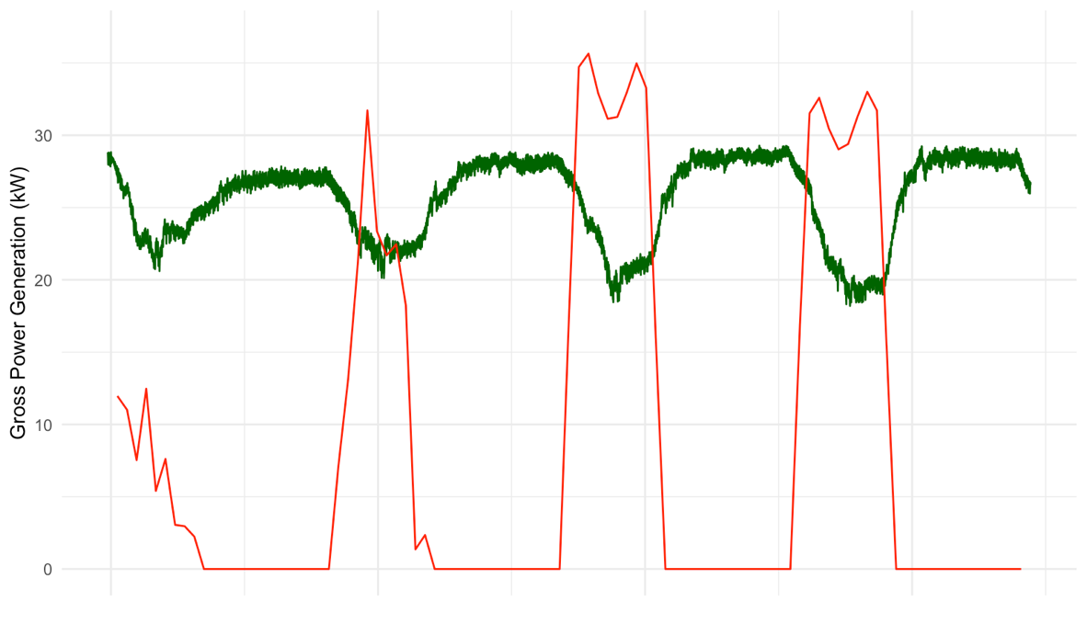
Solution to the Duck Curve: Geothermal
Green = Actual Blackburn
Power Generation
Red = Modeled Solar Generation from NREL PvWatts
Feb 21
Feb 22
Feb 23
Feb 24

Slide 10
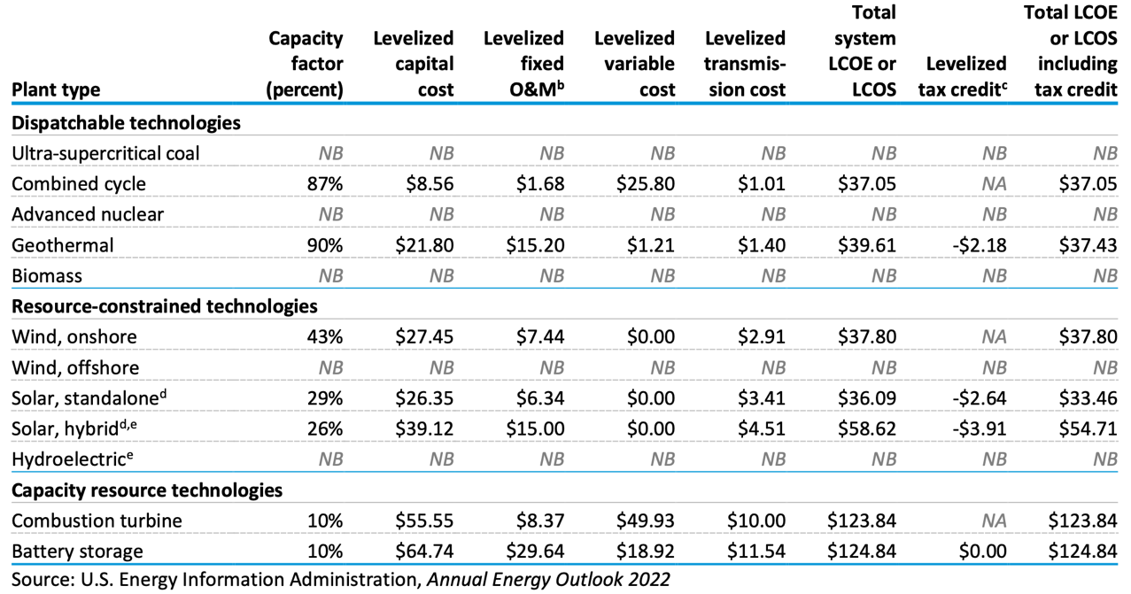
Renewable Capacity Factors & Levelized Costs

Slide 11
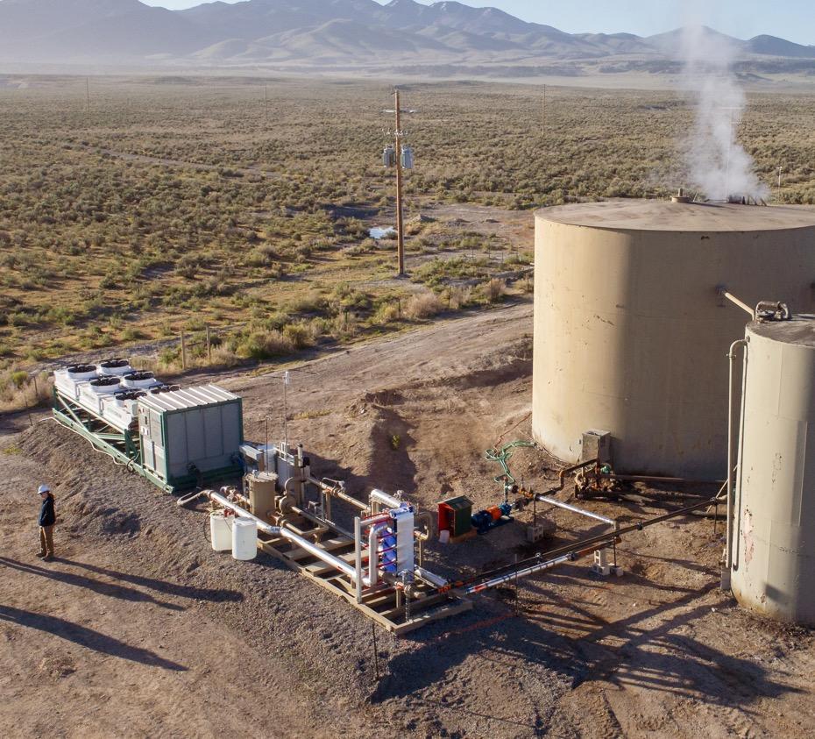
Summary
Traditional energy has historically delivered high standard of living
Geothermal is a solution to decarbonize subsurface energy
Reuse of existing facilities
Duck curve pricing pressure
Geothermal-solar hybrid
LCOE of geothermal benefits from high capacity factors

