Slide 1
Forecast for Green Hydrogen
Dr. Paul Matter
Wall Street Green Summit
March 13, 2024

Slide 2
Existing Market
Hydrogen production emits
~1 gigaton of CO₂/yr
2-3% of global CO₂ emissions $100B Market
AMMONIA
REFINING
METHANOL

Slide 3

Growth Markets
Clean Hydrogen can eliminate an additional
~8-10 gigaton of CO₂/yr
20% of global CO₂ emissions $1T Market Size
LONG DISTANCE
TRANSPORTATION
RENEWABLE ENERGY
STORAGE
SYNTHETIC FUELS

Slide 4
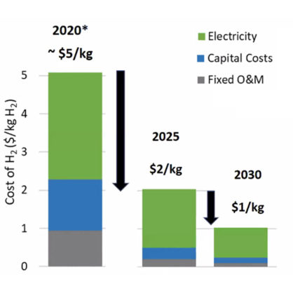
The Hydrogen Challenge

Slide 5
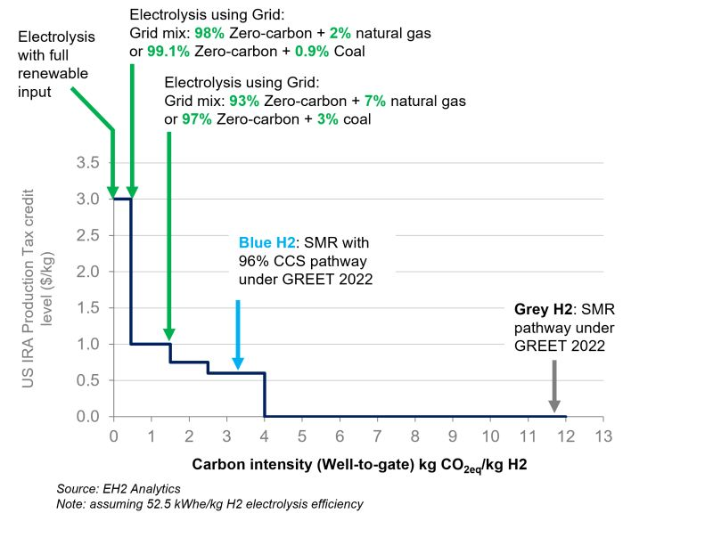
45V Rules*
Incrementality
Temporal matching
Deliverable transmission

Slide 6
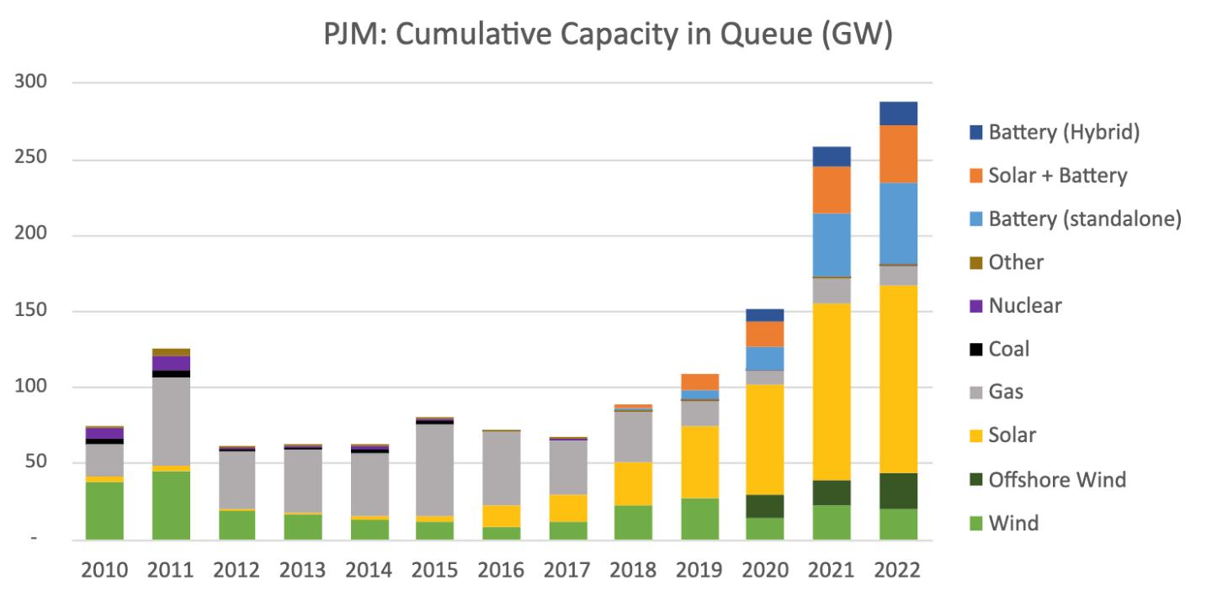
Behind the Meter
Interconnection queue:

Slide 7
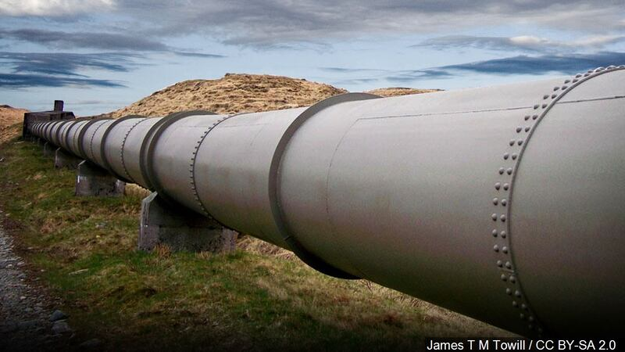
Transportation
Dedicated pipelines
At least 4% hydrogen in natural gas
Pressure beneficial

Slide 8
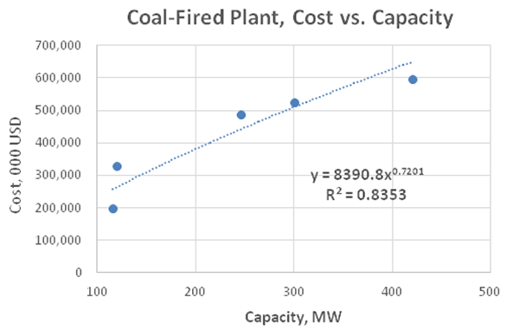
Manufacturing Costs
Bigger is cheaper
Not better for intermittency

Slide 9

Customer Adoption
Interest rates are high
Projects are riskier
  new technology
  new operating method

Slide 10
Forecast for Green Hydrogen
Near-term:
  Renewable tied
  Smaller projects
  Near existing users or blended with natural gas
Long-term:
  Larger projects
  Dedicated pipelines
  Expanding applications

Slide 11
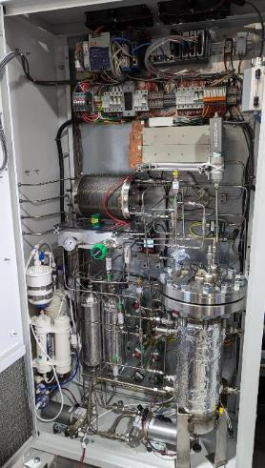
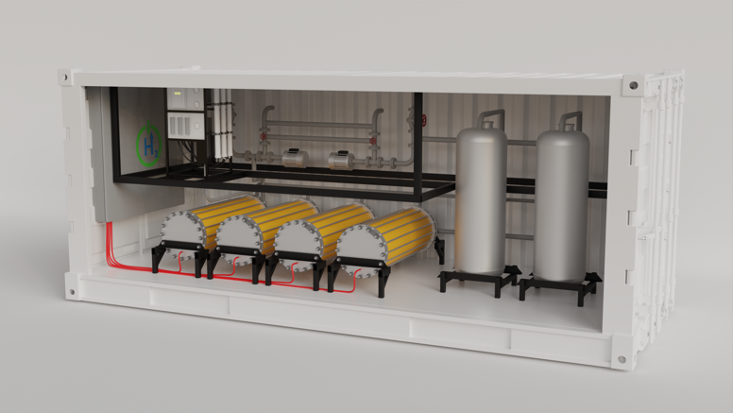
Power to Hydrogen’s Products
Patented hybrid membrane / liquid alkaline design
Low-cost components and load following
10-kW Demo Systems
MW-scale Systems

Slide 12
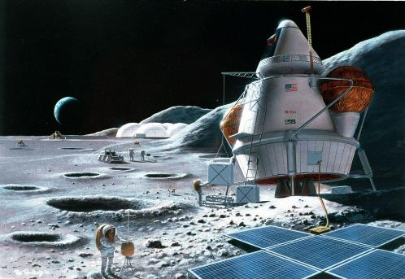
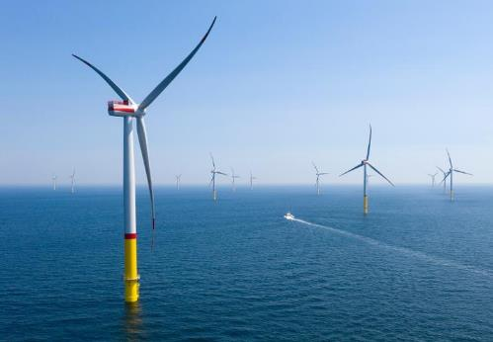



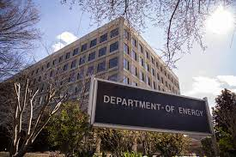


Project Examples
Energy Storage
Industrial H₂
Fueling Stations
High Pressure H₂

Slide 13





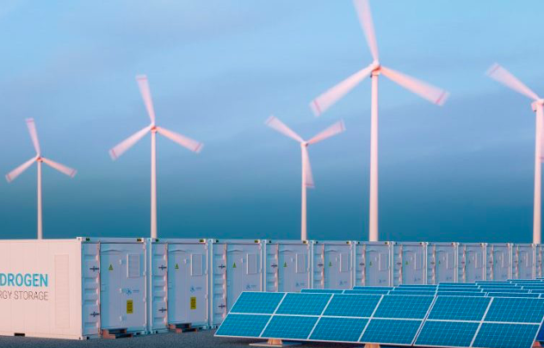
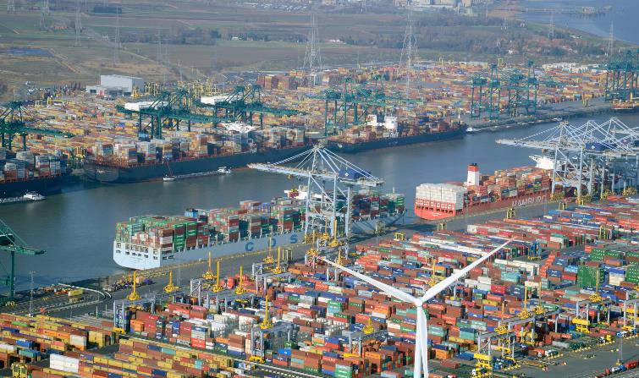
Projects Continued
10-kW Pilot (2023)
Customer Need: Renewable compatible tech to produce H₂ for industrial customers
10-kW Pilot (2023) + MW-scale Pilot (2024)
Customer Need: Renewable compatible tech for various customer and industrial end uses

Slide 14
Questions?
Contact: Paul Matter, CEO, Paul@power-h2.com

